Slide 1
Value
Elements of Art

Slide 2
Objectives
Student will develop skills in value drawing by a full range of values from black to very light.
Students will develop techniques in shading by using a variety of tools such as blending stumps.
Student will develop observational skills that will help them determine where light source is coming from and how that causing the different values on an object.
Student will develop craftsmanship by selecting, cropping, cutting, and gluing a character of their choice into their drawing.

Slide 3
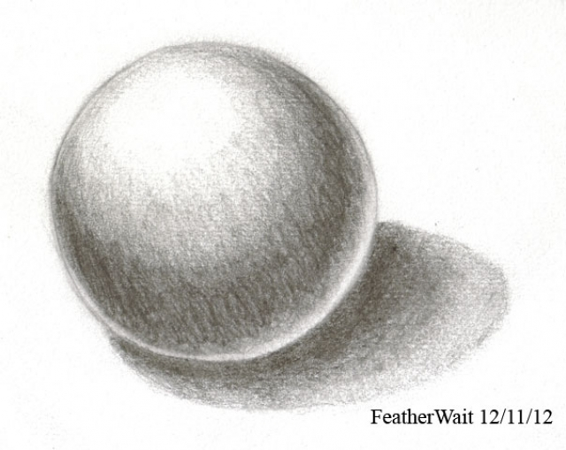
Challenge:
On the back of your paper, attempt to draw the image below to the best of your ability:

Slide 4
Review & Assess
Answer the following:
1. Did you accurately shade the sphere?
2. What is shading anyway?
3. What type of pencil should you use to shade?
4. How should you hold the pencil when shading?
5. How do you create dark layers using shading?
6. What does it mean when you “blend?”
7. What is the blending tool called?
8. What are the Five Elements of Shading?
9. How do you determine where the shadow of your object goes?

Slide 5
Step 2:
Turn paper over & complete questions:
Value Scale:
2. Blended Value Scale:

Slide 6
What is Value?

Slide 7
What is Value?
Value is an Element of Art.
What are the other Elements of Art we have learned about?
Value is the range of lightness and darkness within a picture.

Slide 8
Question:
How is Value created?

Slide 9
Answer
How is Value created?
Value is created by a light source that shines on an object creating highlights and shadows.

Slide 10
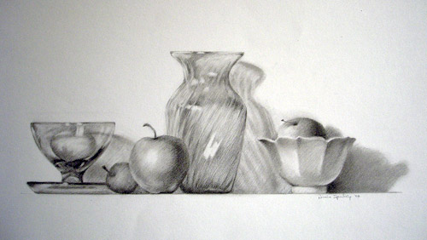
Example of Value

Slide 11
Value Scale
A Value Scale is a scale that shows the gradual change in value from its lightest value, white, to its darkest value, black.

Slide 12
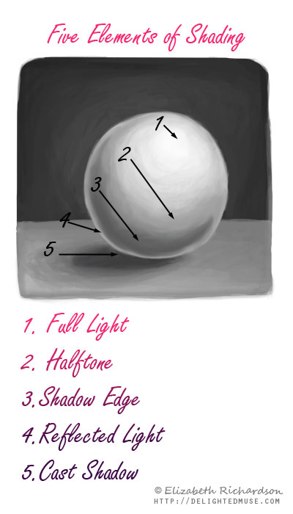
Step 3:
Review the 5 Elements of Shading worksheet in folders.
List and label the Five Elements of Shading for Questions 4 & 5.

Slide 13
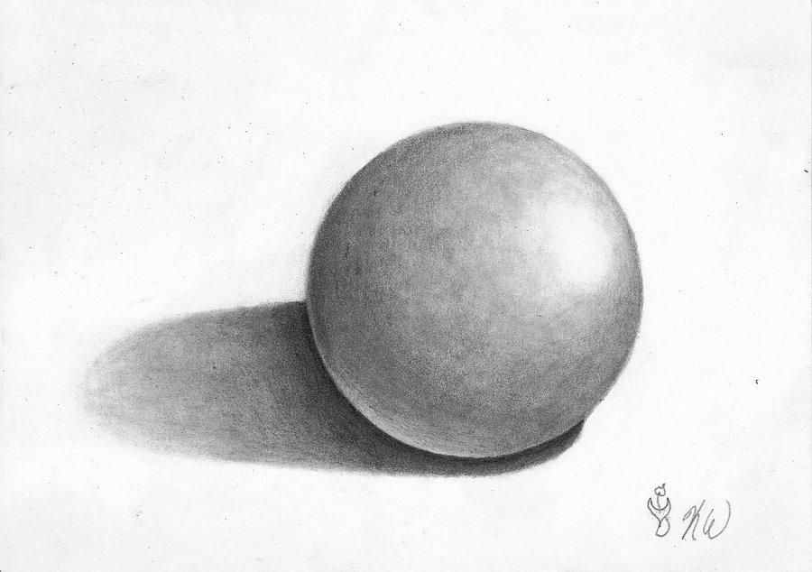
Step 4:
Follow along with Miss Warner’s demo to create a realistic looking sphere.

Slide 14
Challenge:
The gradual shades of our values are IMPORTANT!
This activity will show you why!
Using our new table groups, we are now going to create a group Sphere Shading.
When I say go, begin the first step of sphere shading using the Five Elements of Shading:
When I say switch, pass your paper to the person to the right of you at your table. That person will continue your drawing using the next Element of Shading.
When I say switch, we will pass the paper to the right again and continue the next step.
The goal:
Make the sphere appear as though the same person shaded it!

