Slide 1
REMINDERS!!
Things Due Tomorrow:
Sketchbook Homework #2
Self-Expressive Sketchbook Cover with Artist Statement
Don’t forget to study for:
Vocabulary Quiz #2

Slide 2
Still Life

Slide 3
Objectives
Today we will…
Understand the importance of still life drawing and how it has been used in art.
Discover the benefits of using still lives in art.
Practice improving our observational drawing skills.

Slide 4
What is a still life?
Let’s take this time to discuss what we’ve learned about still lives this week so far...

Slide 5
What is a still life?

Slide 6
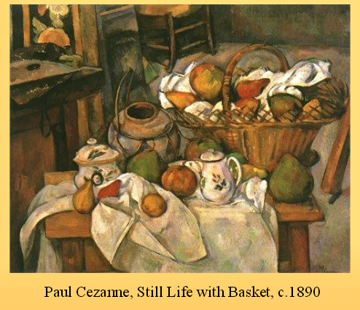

Slide 7
History of Still Life Painting
Became popular during the Renaissance
Originally held religious significance on church walls
Later, Leonardo da Vinci began setting up fruit to do studies of natural objects… resulting in the beginning of non-religious still life paintings.

Slide 8
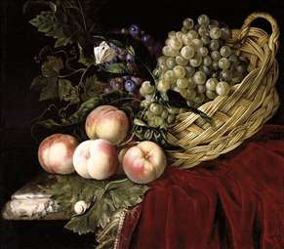
Da Vinci Still Life

Slide 9
Why Still Lives?
Still life drawings and paintings help us learn to develop our observational skills by looking at common 3D objects and recreating them in 2D form.
There many other benefits to using still lives…

Slide 10
Benefits of still life drawing
If you don’t like the way something looks, you can add or remove objects.
You can adjust the lighting to create different highlights and shadows.
You can change where and how the objects sit.

Slide 12
Benefits of still life drawing

Slide 13
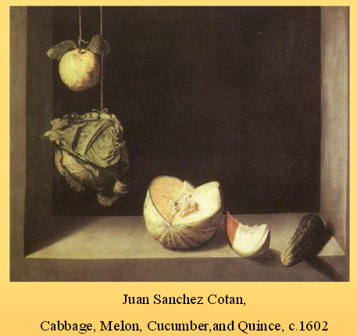

Slide 14
Benefits of still life drawing

Slide 15
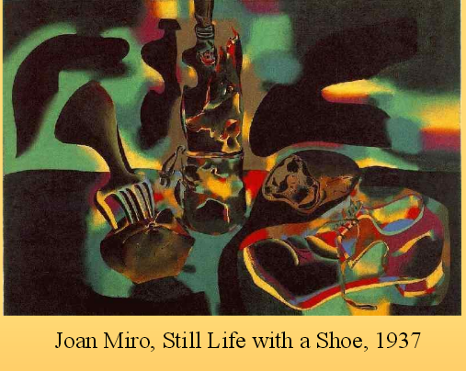

Slide 16
Famous Still Life Types
Throughout history, there have been many artistic movements that have utilized still lives in their work.
The following are the most famous.
Please take note of the different styles.

Slide 19
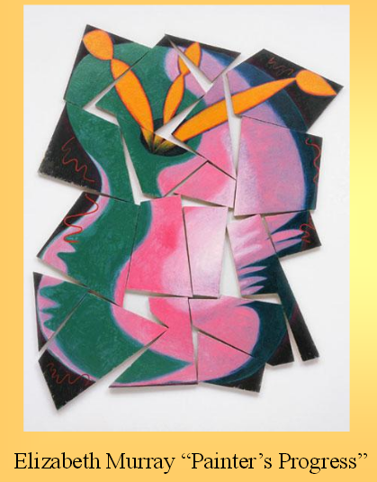
What are some common characteristics that you notice about Cubist still lives?

Slide 22
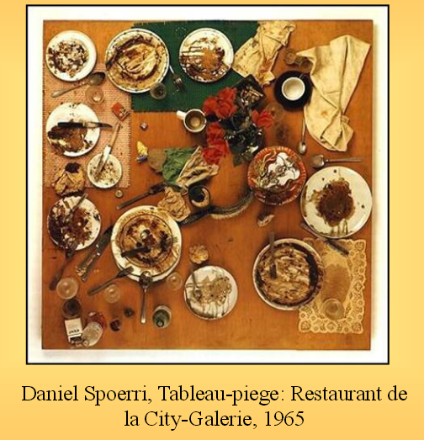
What are some common characteristics that you notice about Trompe Loleil still lives?

Slide 23
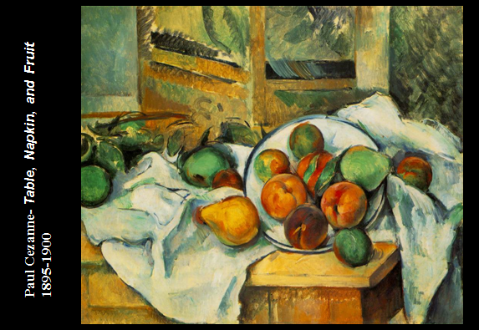
Post-Impressionism

Slide 24
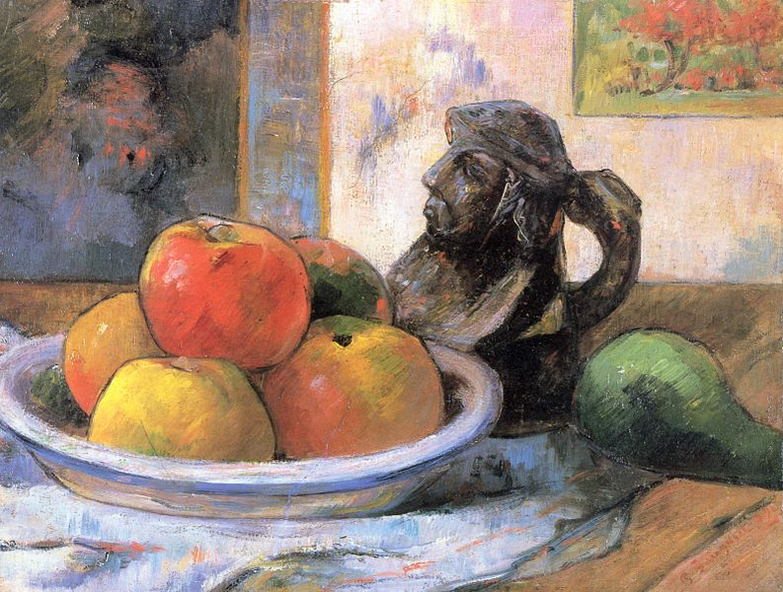
Paul Gaugin

Slide 25
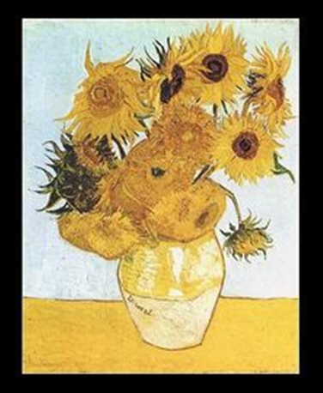
Post-Impressionism
What are some common characteristics that you notice about Post-Impressionism still lives?

Slide 26
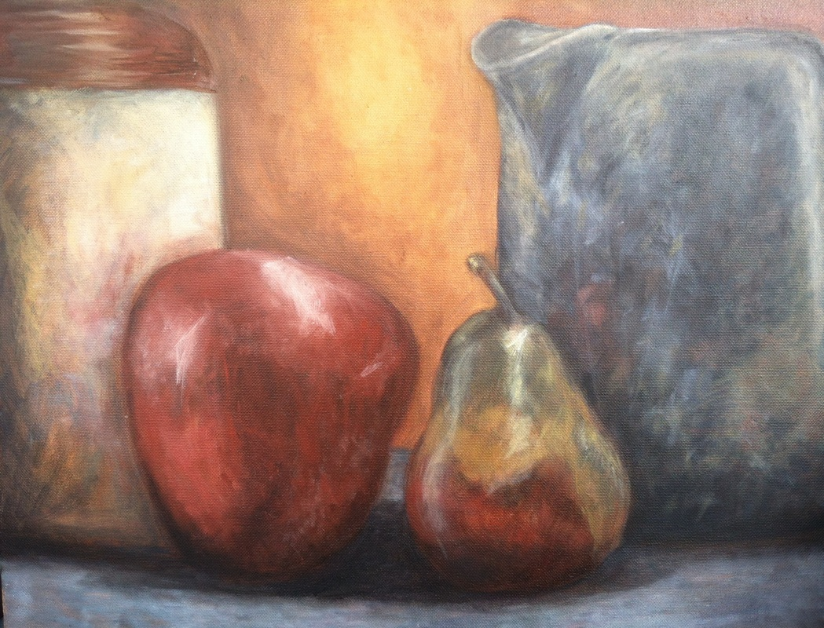
Miss Warner… wants to be an Post-Impressionist!

Slide 27
The Keys To Still Life Drawing
The artist draws what they see, not what they think they see.
The artist focuses on the lines, shapes, and curves of the object to accurately create the shape.

Slide 28
Drawing What You See… Not What You Think You See!
To most challenging thing about still life drawing is looking at the object and accurately drawing the shape.
To practice, we are now going to spend time looking at simple shapes and attempting to redraw them.

