Slide 1
Space
Elements of Art

Slide 2
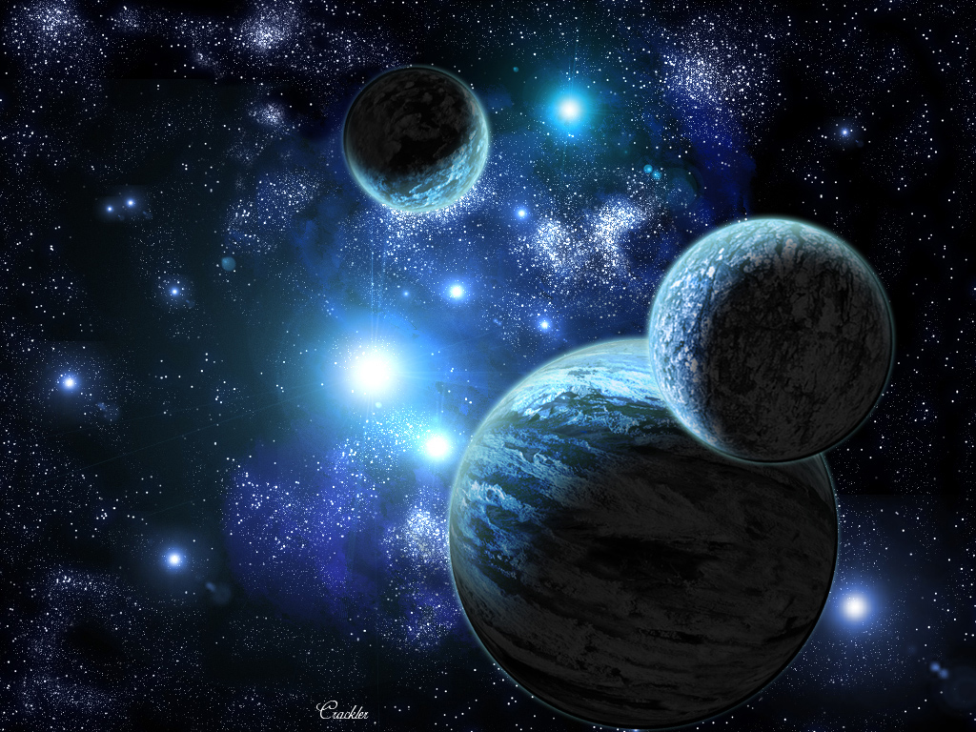
This is not the Space we are talking about in Art!

Slide 3
What is Space?
Space is an Element of Art.
What two other Elements of Art have we learned about?
IN 3D Art:
Space is the three-dimensionality of a sculpture.
With a sculpture or architecture you can walk around them, look above them, and enter them, this refers to the space of the sculpture or architecture.

Slide 4
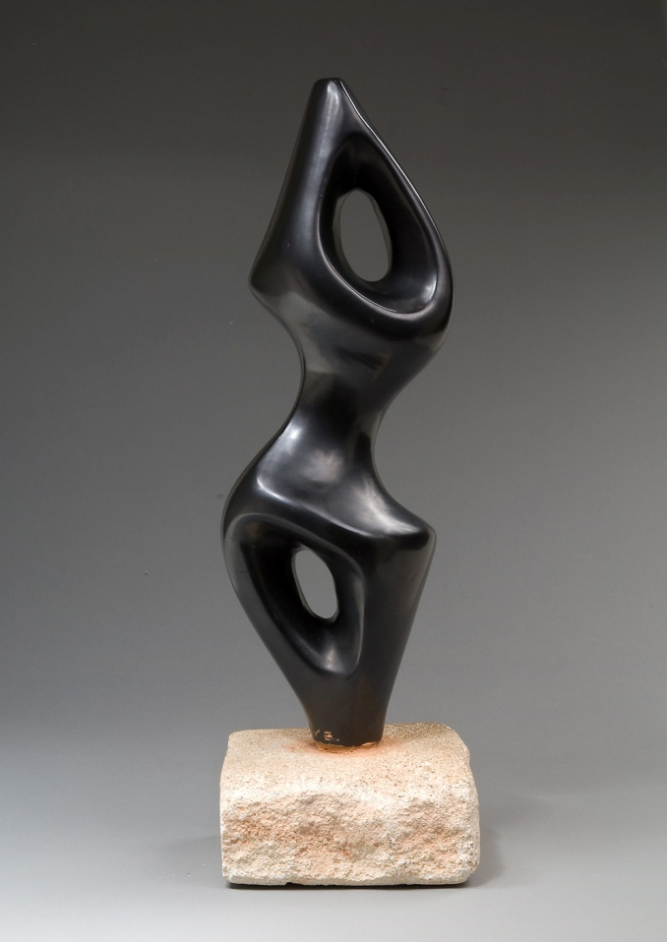
Example of 3D Space

Slide 5
What is Space?
IN 2D Art:
Space in a two-dimensional drawing or painting refers to the arrangement of objects on the picture plane.
The picture plane is the surface of your drawing paper or canvas.
You can have a picture plane that is a crowded space with lots of objects or an empty space with very few objects in the picture plane.
A two-dimensional piece of art has height and width but no depth.
The illusion of depth can be achieved by using perspective.
This is the technique used to have your picture look likes it is moving to the distance like a landscape or cityscape.

Slide 6
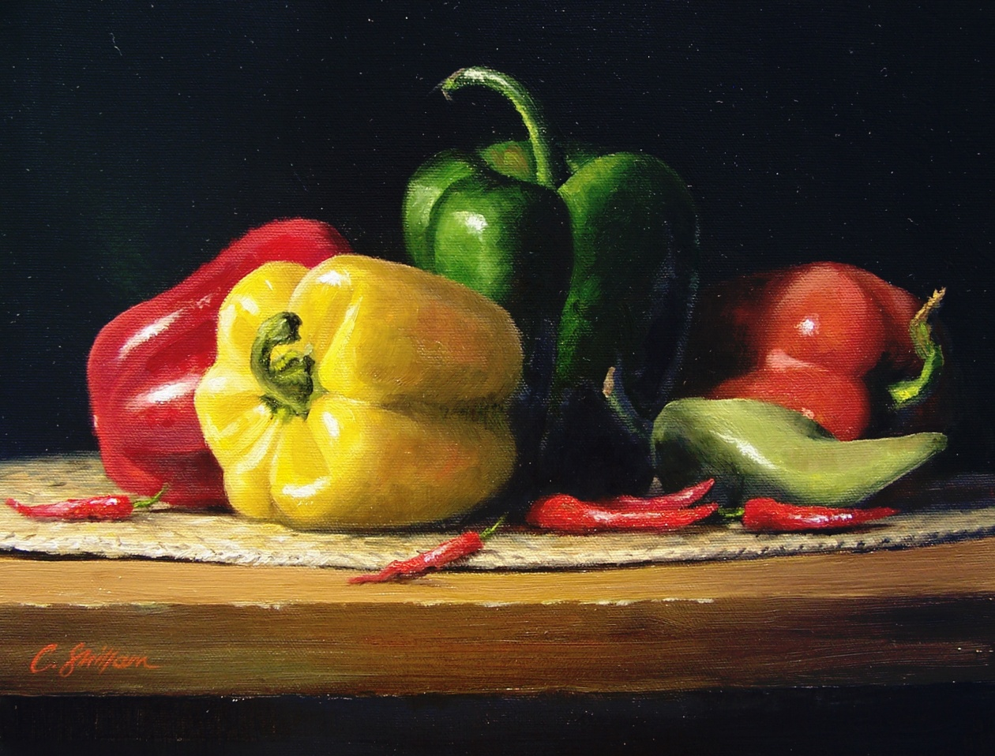
Example of 2D Space

Slide 7
Categories of Space
Positive space-
In a drawing or painting positive space is the solid forms in a design such as a bowl of fruit.
In a sculpture it is the solid form of the sculpture.

Slide 8
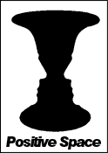
Positive Space Example

Slide 9
Categories of Space
Negative space-
In a drawing it is the space around the positive shape or the shape around the bowl of fruit.
In sculpture it is the empty shape around and between the sculptures.

Slide 10
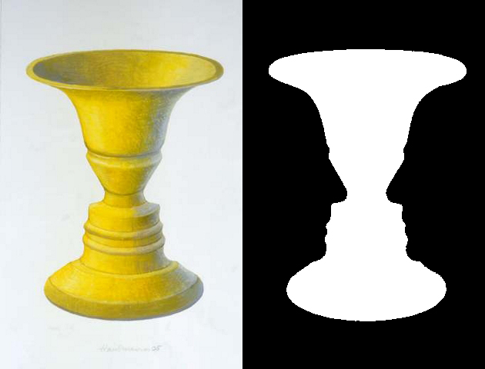
Negative Space Example

Slide 11
Categories of Space
Picture Plane is the flat surface of your drawing paper or canvas.

Slide 12
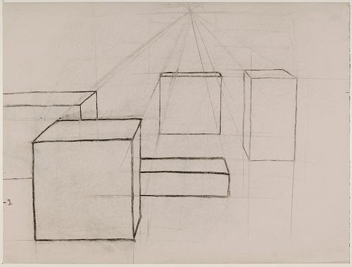
Picture Plane Example

Slide 13
Categories of Space
Composition is the organization and placement of the elements on your picture plane.

Slide 14
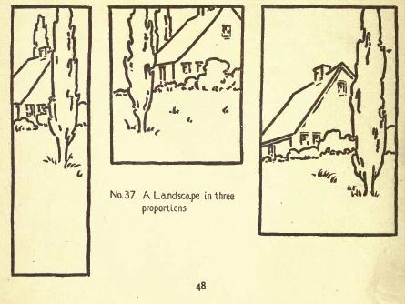
Composition Example

Slide 15
Try it:
In your art notebook, draw and label a picture with both positive space and negative space.

