Slide 1
Shape
Elements of Art

Slide 2
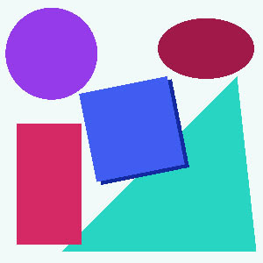
What is Shape?
Shape is an Element of Art.
What is the other Element of Art we learned about last week?
When a line crosses itself or intersects with other lines to enclose a space it creates a shape.
Shape is two-dimensional.
It has height and width, but no depth.

Slide 3
Categories of Shape
Geometric Shapes:
Circles, squares, rectangles and triangles.
We see them in architecture and manufactured items.
Always symmetrical:
Parts that are exactly alike on both sides.
Organic Shapes:
Leaf, seashells, flowers.
We see them in nature and with characteristics that are free flowing, informal and irregular.
Always asymmetrical:
Parts that are not equal in shape, size, or arrangement.

Slide 4
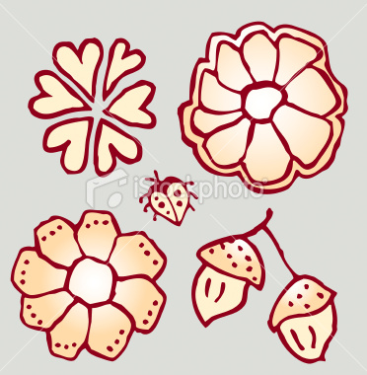
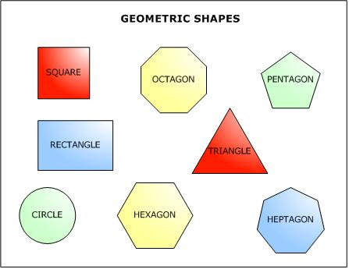
Categories of Shape
Geometric Shapes:
Organic Shapes:

Slide 5
Categories of Shape
Let’s see if you know the difference between the two!

Slide 6
Organic or Geometric?

Slide 7
Organic or Geometric?

Slide 8
Organic or Geometric?

Slide 9
Organic or Geometric?

Slide 10
Organic or Geometric?

Slide 11
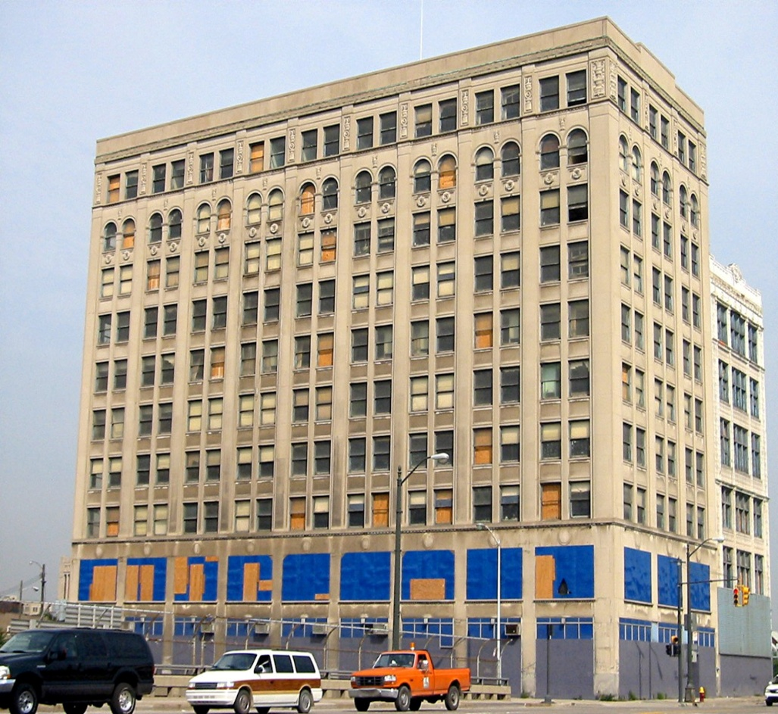
Organic or Geometric?

Slide 12
Organic or Geometric?

Slide 13
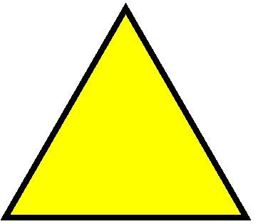
Organic or Geometric?

Slide 14
Organic or Geometric?

Slide 15
Organic or Geometric?

Slide 16
Try it:
In your art notebook, draw three examples of geometric shapes and three examples of organic shapes.

