Slide 1
Expressive Sketchbook Covers
Project #1

Slide 2
Week 1 Vocabulary
Sketchbook: A pad or book of drawing paper for sketching on.
Collage: A work of art created by gluing pieces of paper, fabric, photographs, or other materials onto a flat surface.
Media: The materials we use to create art with.
Mixed Media: The use of a variety of media in Art.
Self-Expression: The expression of one’s feelings, thoughts, or ideas in Art.

Slide 3
Supplies
You Will Need:
1 Large Sheet of Construction Paper
Markers and/or colored pencils
Scissors
Glue
Magazines
A photo of yourself (bring in for homework or use the one I take in class)
Various papers (tissue, construction, etc.

Slide 4
Goals
To create expressive sketchbook covers that will be used in binding your class sketchbook.
Students will experiment with and use mixed media in creating these covers.
The finished covers will show evidence that the student incorporated required materials and that the covers are expressive of the student.
The final sketchbook will be used to plan out ideas, do sketch assignments and develop artistic skill.

Slide 5
Project Requirements
The following must be included on your cover:
All of the following:
Black/White photo of you
Text/Descriptive words
Your name
1 or more of the following:
Colored paper/Collage materials
Magazine cut outs
Images/text from the Internet
Notes
Cards
Tags
Wrappers
Labels
1 or more of the following:
Pastel
Colored pencil
Marker

Slide 6
Grading
You will be graded on the following:
1. Brainstorm Worksheet
2. 3 Planned Sketches
Final Covers:
3. You used all required materials and included all required information/images
4. Your covers are expressive of you/tell us something interesting or important about you
6. Your covers are interesting and creative
7. Both covers are covered completely/no blank/negative areas
8. Binding of the cover to the pages.

Slide 7
Step 1:
Each student will complete a Sketchbook Cover Brainstorm Assignment:
One of the requirements of this assignment will be that you will tell us something interesting or important about you through the images/words on the paper.
You will make a list of words that describe you, your likes or dislikes, your personality, or anything you can think of that you would like to share.
Do not reject any ideas here. Brainstorming is creating a list you will refine later. Some things will be easier to portray then others but more choices will make the start of the assignment less scary.

Slide 8
Expressive Sketchbook Covers Brainstorm
Directions: Complete the following information on a separate piece of paper in order to develop ideas to use on your sketchbook covers.
Brainstorm at least 10 words that describe you and your personality.
Write down your favorite 3 things to do/interests/hobbies.
Describe your favorite place to go or some place you would like to go.
What are your favorite colors?
What kind of music do you like?
What is your favorite food?
Do you have any pets?
What are your favorite school activities are (sports, clubs)?
What else can you write about that could be included on your sketchbook covers?

Slide 9
Step 2:
Plan out sketches of the three things you would like to share:
A sketch is a small design that looks at how to place things on the page in an interesting way. It will involve deciding what images to include, where to place them on the page, what colors you will use, and what types of media you will use.
YOU MUST DO THREE FOR THE TOTAL POINTS for this part of the project!
Every cover must also have your name incorporated into the layout.

Slide 10
Step 3:
The final requirement is that you must use the picture I take of you in class:
It will be printed black/white, but you can add color to it using colored pencil, highlighter, and marker.
This photo should be the main focus of the front cover of your sketchbook.
It should be altered in some way and collaged into the cover with other collage materials.

Slide 11
Step 4:
Be creative!
You may use any material you wish (i.e. paint, markers, colored pencils, computer images, etc).
Craftsmanship is important because this is what you will look at many days in this class from now until the end of the year.
Create something you will be proud of and want to share.

Slide 12
Step 5:
Bind cover to pages:
Give project to Miss Warner so cover can be laminated.
Select 25 sheets of white printer paper and 3 hole punch each sheet.
Fold cover in half (if you haven’t already) and 3 hole punch the cover.
Place pages inside the cover and line up the holes.
Using the string, bind the pages together through the holes.

Slide 13
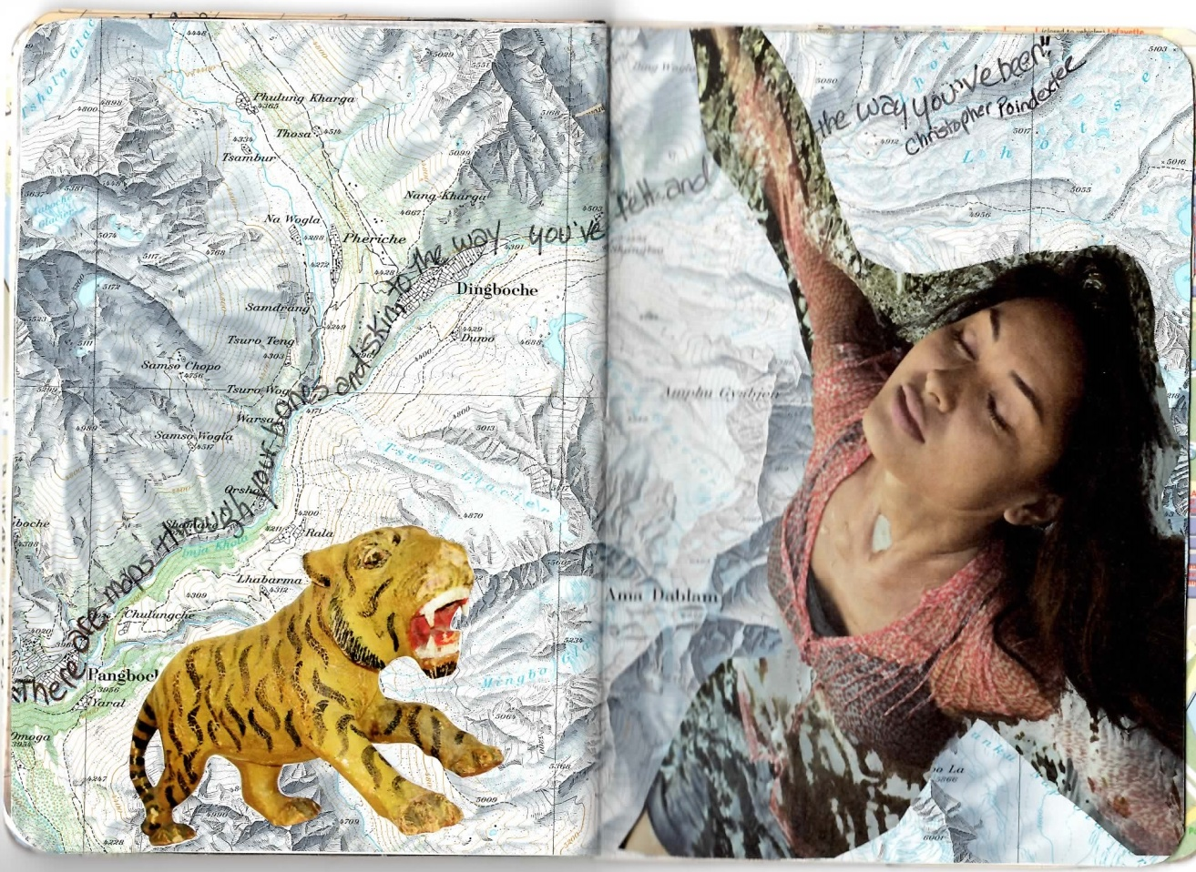
Student Samples

Slide 14
Student Samples

Slide 15
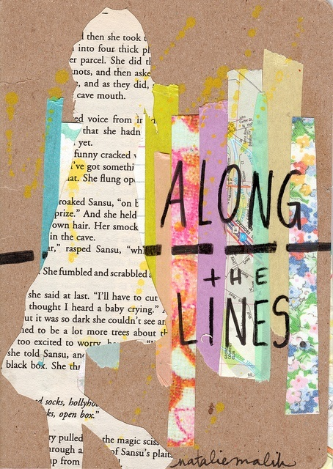
Student Samples

Slide 16
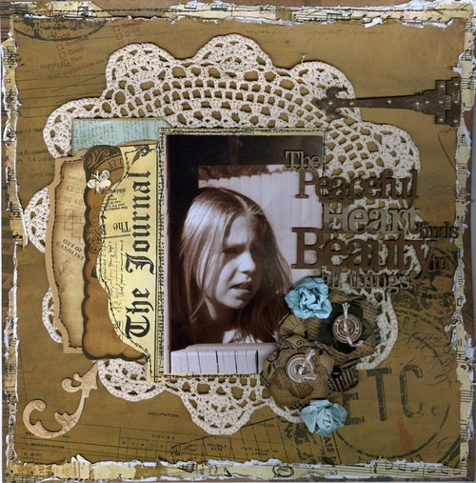
Student Samples

Slide 17
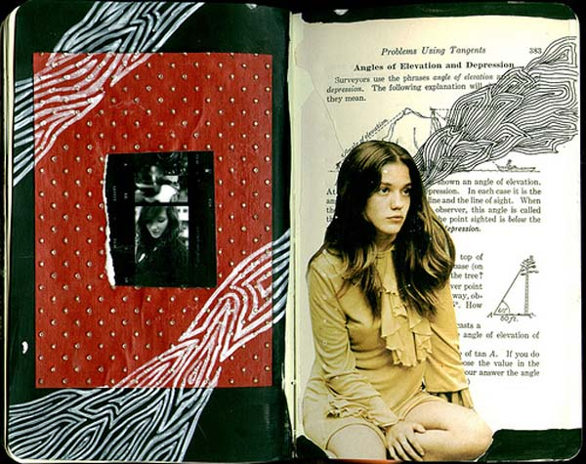
Student Samples

Slide 18
Student Samples

Slide 19
Student Samples

Slide 20
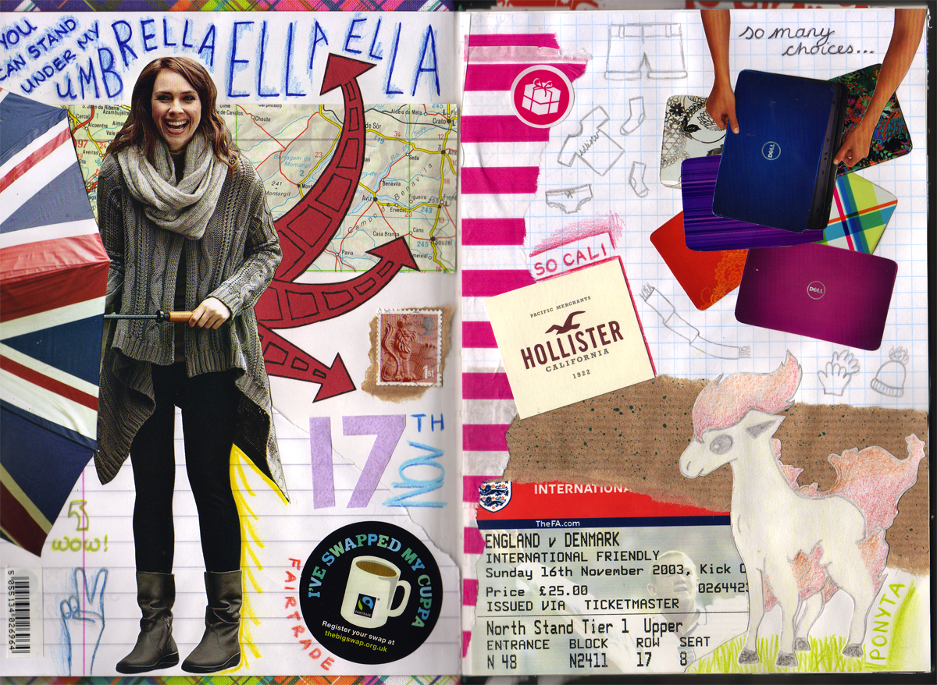
Student Samples

