Slide 1
Line
Elements of Art

Slide 2
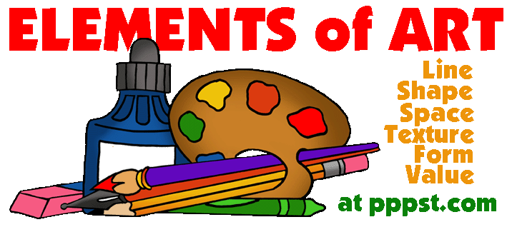
What is an Element of Art?
The Elements of Art are…
The building blocks used by artists to create great works of art.
There are six Elements of Art.

Slide 3
Line
What is a line? (In Art Terms, Not Math!)

Slide 4
Definition of Line
Line is…
A mark with greater length than width.
What is length?
What is width?
An Element of Art.
Never ending.

Slide 5
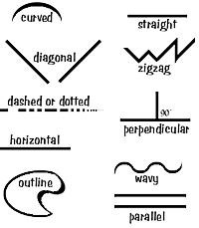
Characteristics of Line
Lines have many characteristics:
Width
Length
Direction
Focus
Feeling

Slide 6
Line Width
What are some examples of line width?

Slide 7
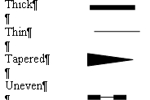
Line Width
Width: Thick, thin, tapered, uneven

Slide 8
Line Length
What are some examples of line length?

Slide 9
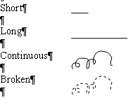
Line Length
Length: Long, short, continuous, broken

Slide 10
Line Direction
What are some examples of line direction?

Slide 11
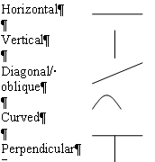
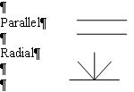
Line Direction
Direction: Horizontal, vertical, diagonal, curved, perpendicular, parallel, radial

Slide 12
Line Focus
What are some examples of line focus?

Slide 13
Line Focus
Focus: Sharp, blurry

Slide 14
Line Feeling
What are some examples of line feeling?

Slide 15
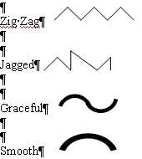
Line Feeling
Feeling: Zigzag, jagged/sharp, graceful, smooth

Slide 16
Try it!
In your art notebook, practice filling up the page with as many different lines as you can!

Slide 17
Pattern
Pattern is…
The repeating of something all over the artwork.
Patterns have repetition.
Repetition is when something repeats over and over to create unity

Slide 18
Try It!
Think of a design and practice repeating that design in your notebook!

Slide 19
Op Art
Op Art is a type of art from that ‘60s that uses optical illusions to trick the eye into looking like the art is moving.
An illusion is when your eyes are tricked into seeing something.

Slide 20
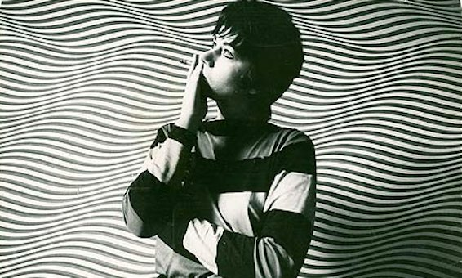
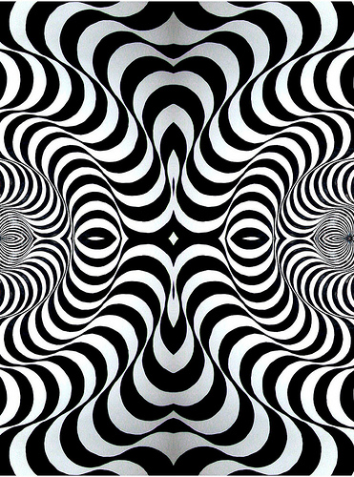
Bridget Riley
Bridget Riley was a famous Op Art artist.
She worked primarily will lines to create movement.

Slide 21
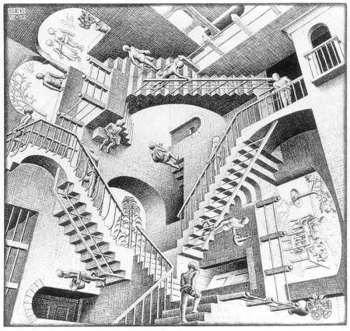
M.C. Escher
M.C. Escher was another very famous Op Art artist.
He created crazy scenes that tricked the eye.

