Slide 2
Objectives
Students will be able to discuss and interpret the style and inspiration of Neo-Classical art.
Students will be able to examine the works of Jacques-Louis David and identify the major historical influences on his art.
Students will be able to compare and contrast the work of Jacques-Louis David and Kehinde Wiley.

Slide 3
Vocabulary Week #1
History painting is a genre of painting the historical events from classical history, Christian history, mythology, or historical events from the near past. Many times events and figures are idealized.
Opulence is great wealth or affluence.
Lineage is a group of people related by descent from a common ancestor.
Neoclassical refers to the 18th- and 19th-century revival in art and architecture of the simple symmetrical styles of ancient Greece and Rome.
Pattern is the repetition of something in an artwork.

Slide 4
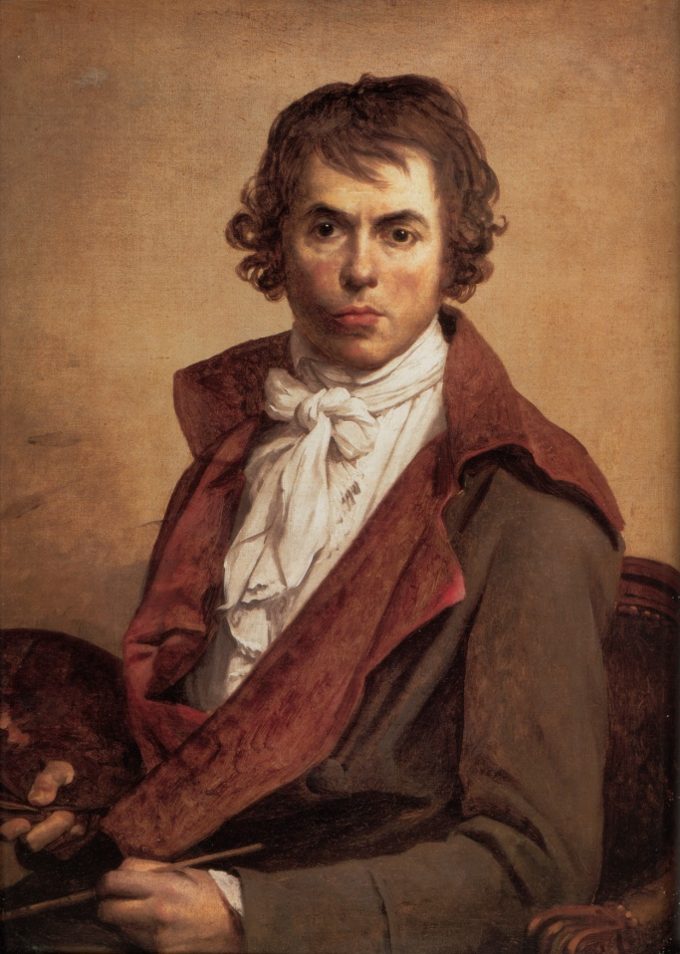
Neoclassical Painting
Jacques-Louis David was an instrumental artist during the French Revolution and in Napoleon Bonaparte’s court.
Painting in the style called Neo-Classicism, David used classical elements to express ideas of nationalism, courage, and greatness.
As a school of painting, Neo-Classicism expressed a visual language of power and authority by claiming a direct lineage to Greco-Roman culture.

Slide 5
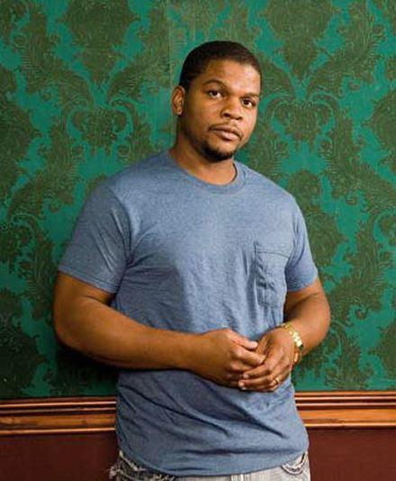
Kehinde Wiley
Influenced by David and other portrait painters, Kehinde Wiley takes cues from this Western European tradition.
Wiley inserts the people he wants to represent into these historical paintings, typically young black men he meets on the street.
Wiley’s artistic practice critiques both the lineage of portrait painters he claims to be artistically descended from, as well as current society.

Slide 6
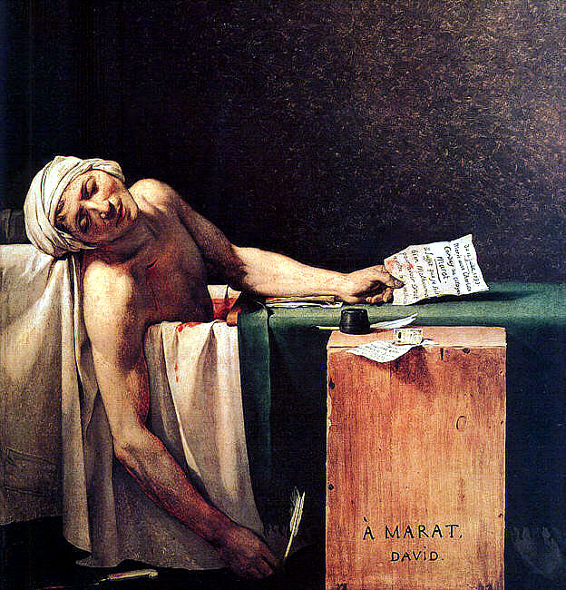
What do you see?
What do you see in the image?
What does the figure seem to be doing? How can you tell?
Where are they?
Describe the attire and postures of the person/people.
What do you think this painting means?
What evidence supports your ideas?

Slide 7
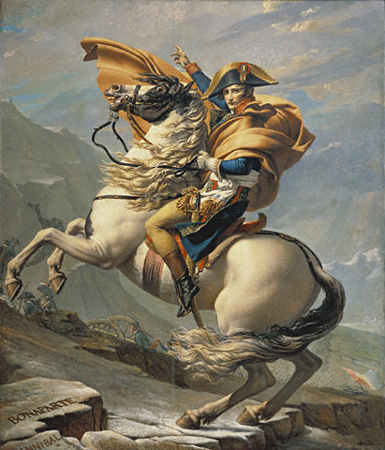
What do you see?
List any recognizable objects.
Define the figure’s posture and the figure’s facial expression.
What type of emotion does the painting convey? What visual evidence supports that idea?
Does this painting present a sense of power or authority? If so, how?

Slide 8
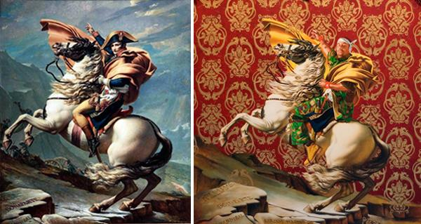
What are some similarities between these two images?
What are some differences between these two images?
When do you think the second painting was painted?

Slide 9
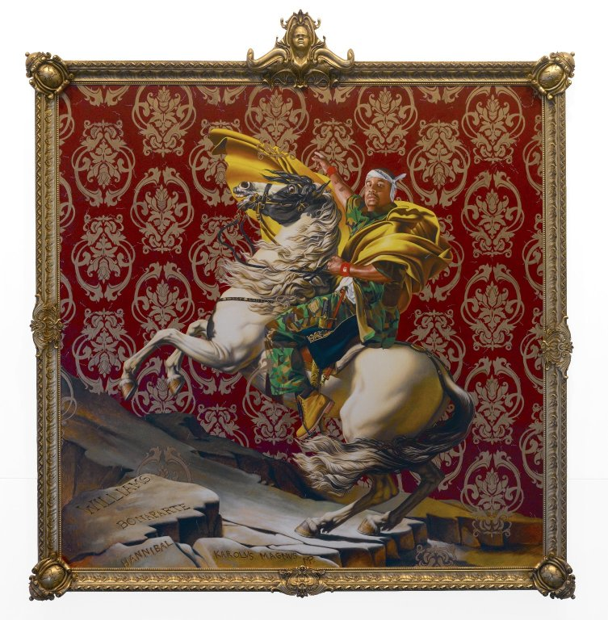
What do you see?
Describe the expression on the person’s face
Where might you see this man?
What happens to the meaning of the artwork by placing a different person into it?
What do you think is artist’s message?

Slide 10
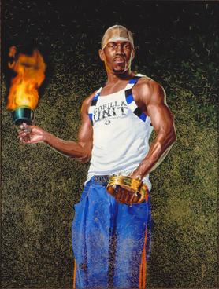
What do you see in the image?
What does the figure seem to be doing? How can you tell?
Where are they?
Describe the attire and postures of the person/people.
What do you think this painting means?
What evidence supports your ideas?

Slide 11
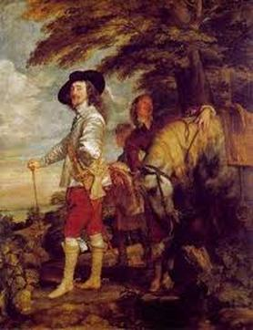
Le Roi a la Chasse Anthony van Dyck (1635)

Slide 12
Kehinde Wiley
http://www.youtube.com/watch?v=vZkRszO8DKI

Slide 13
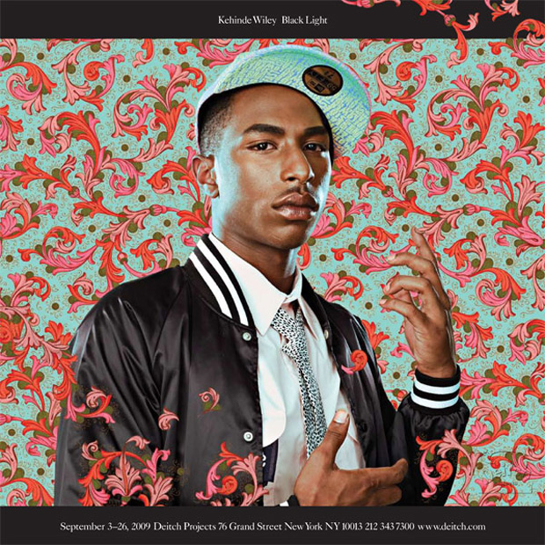

Slide 14
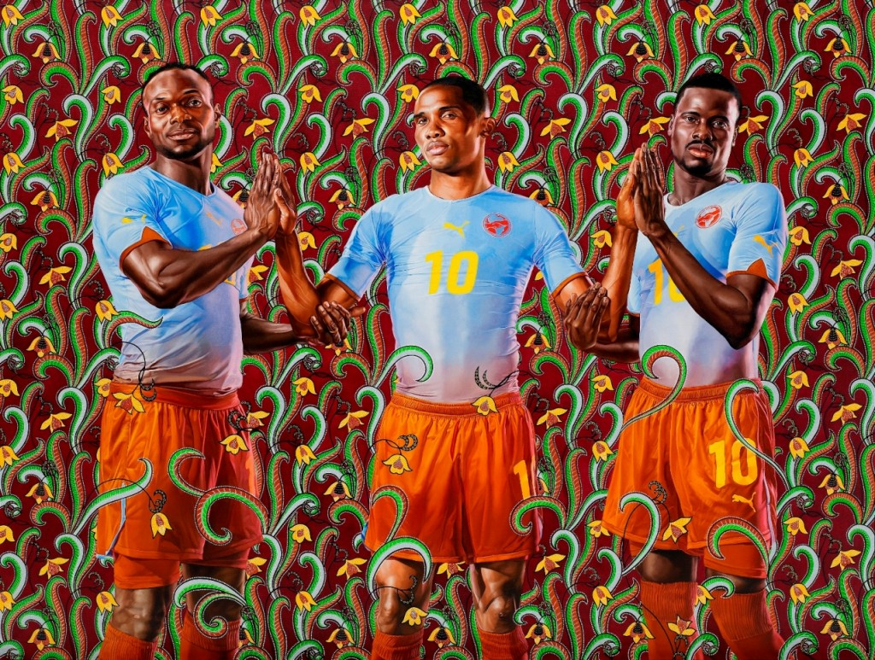

Slide 15
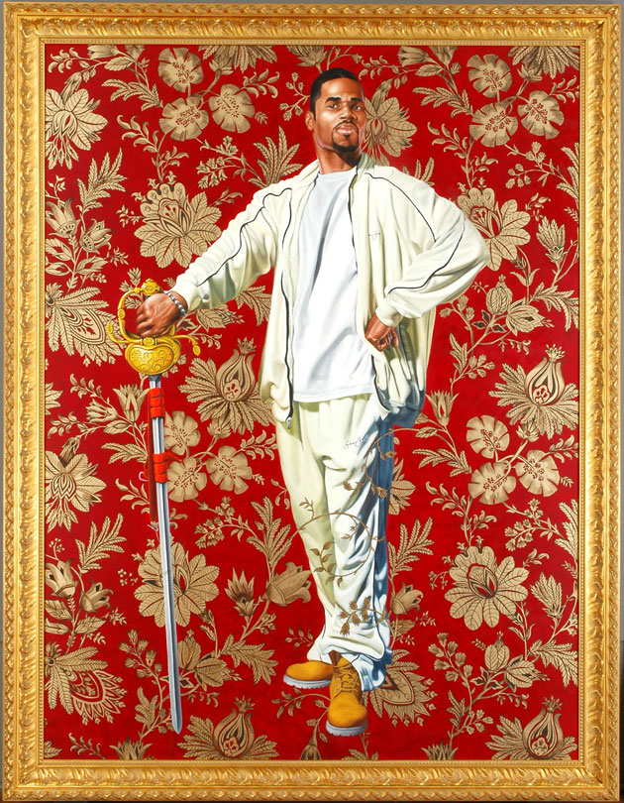

Slide 16
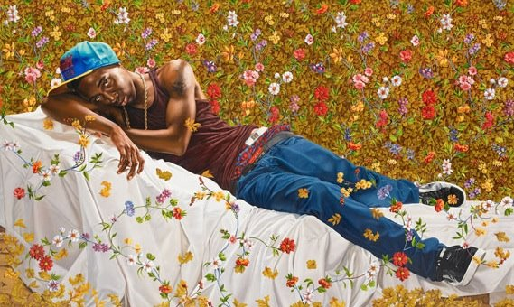

Slide 17
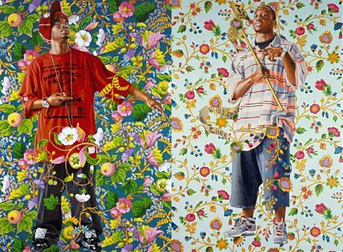

Slide 18
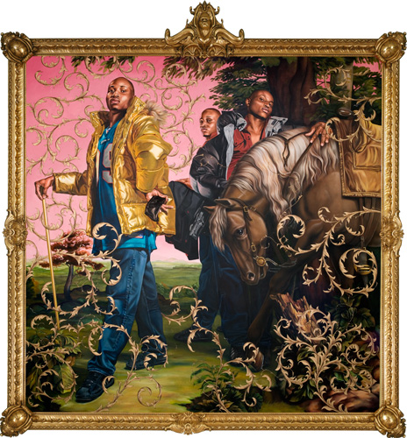
Le Roi a la Chasse Kehinde Wiley (2008)

Slide 19
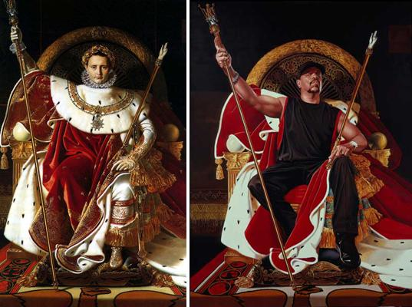

Slide 20
Project Goals
To take a Neoclassical painting and replicate a contemporary self portrait of the student in the style of the original painting inspired by Kehinde Wiley’s contemporary paintings.
Student will continue to develop realistic drawing skills by drawing self in a pose resembling the original painting, exhibiting proper portrait skills, and developing a creative patterned background.

Slide 21
Project Requirements
The following must be included in your drawing in order to receive full credit:
A large scale self portrait in the pose of a Neoclassical painting.
Proper facial feature structure
Patterned background
Fully colored

Slide 22
Grading
You will be graded on the following:
Portrait Practice
3 Ideas of Ways to Modernize the painting
1 Planned Sketch
5 Pattern Ideas
You used all required materials and included all required information/images
How closely the Neoclassical painting pose is reproduced
The resemblance of the portrait to the student
How the patterned background is integrated with the drawing
Craftsmanship
Paper is covered completely/no blank/negative areas
Daily effort

Slide 23
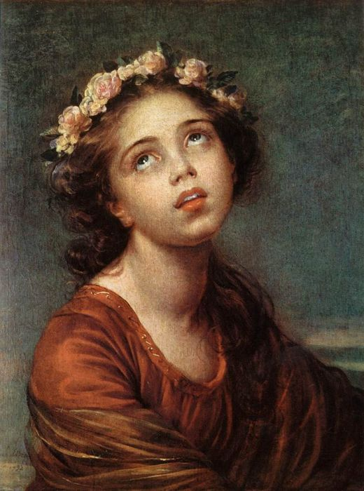
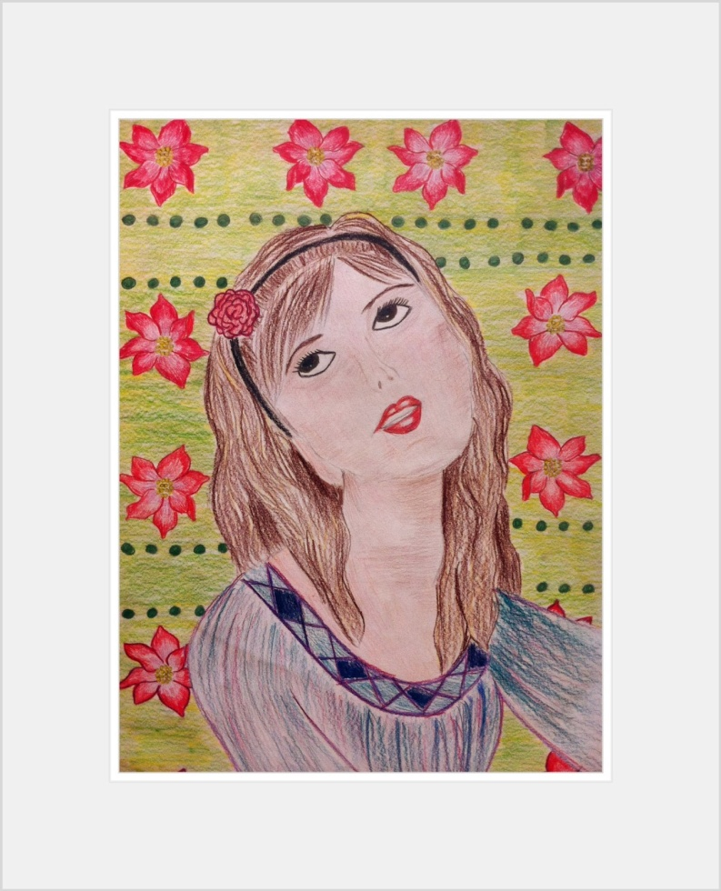

Slide 24
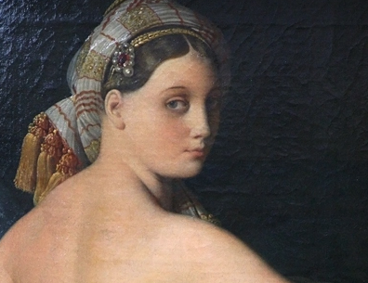
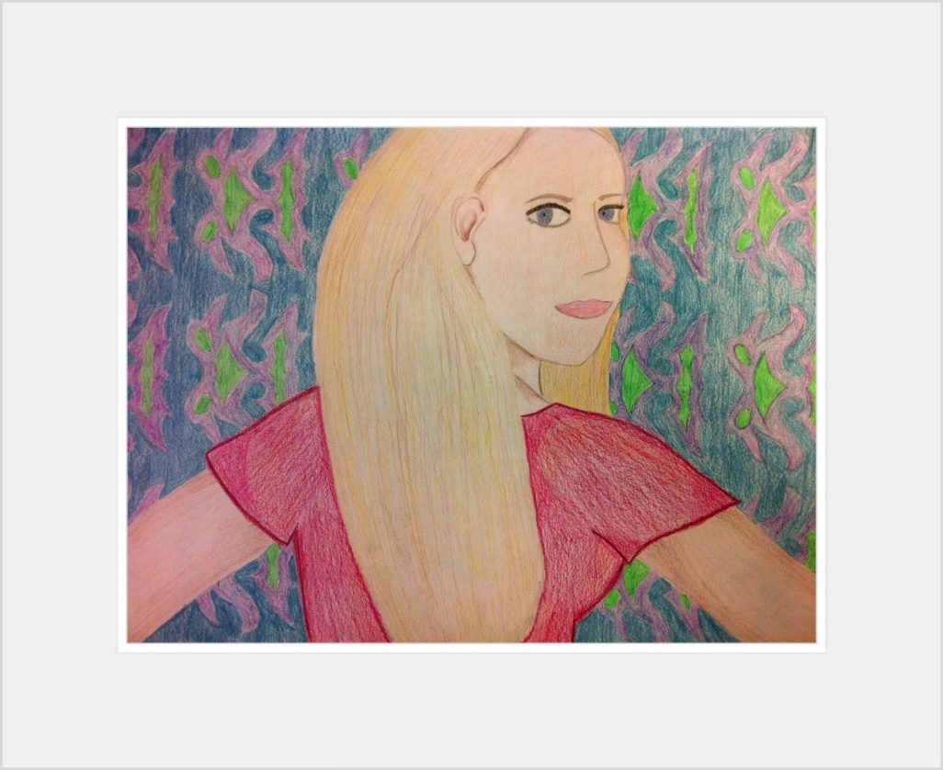

Slide 25
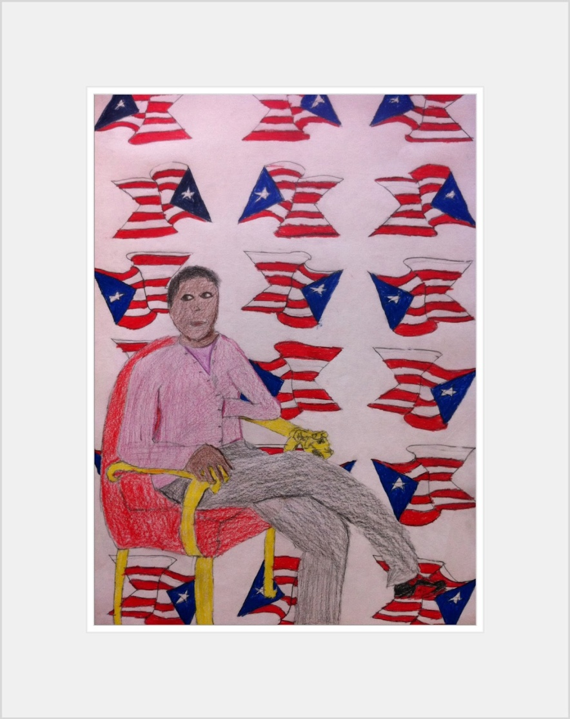
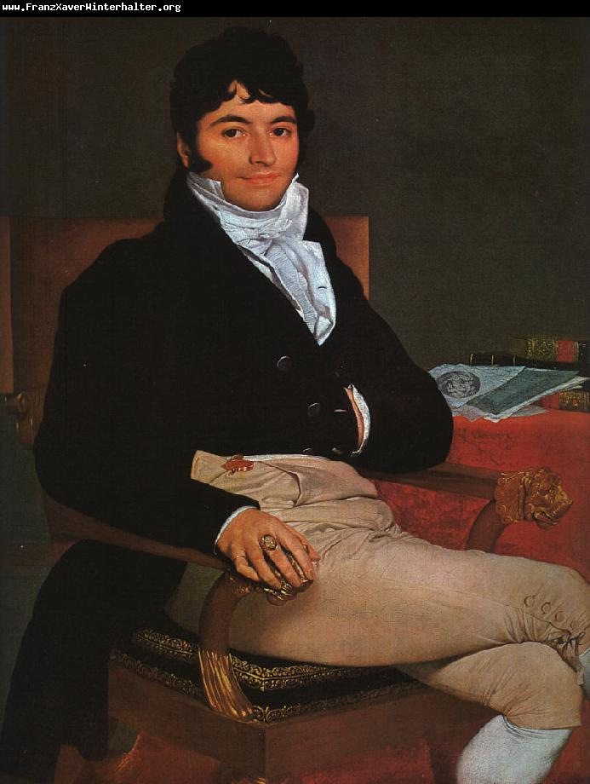

Slide 26
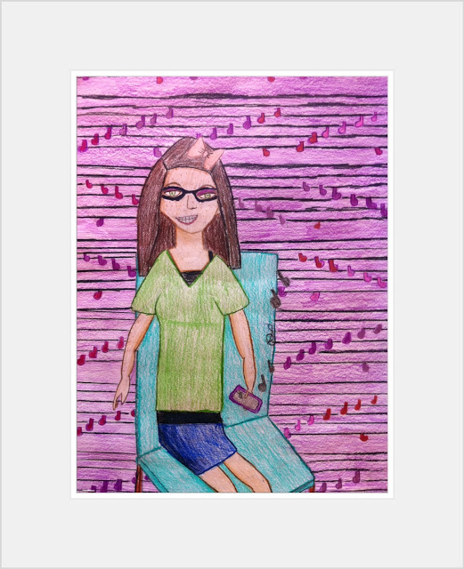

Slide 27
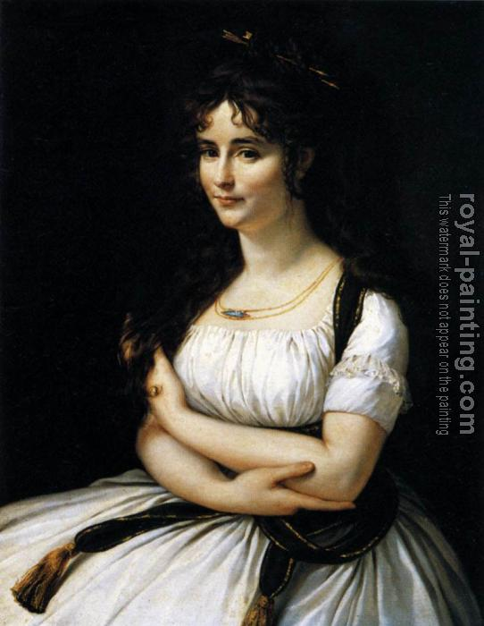
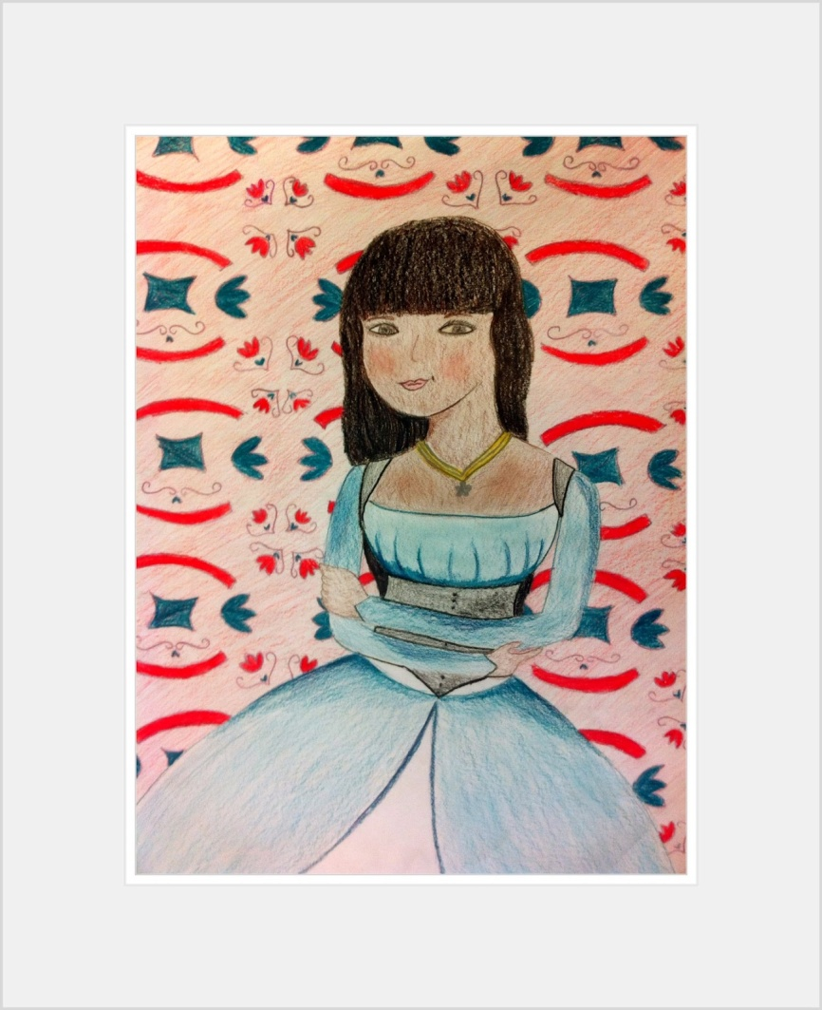

Slide 28
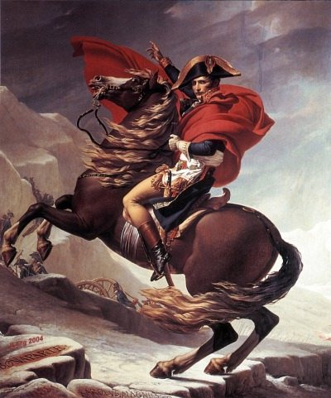
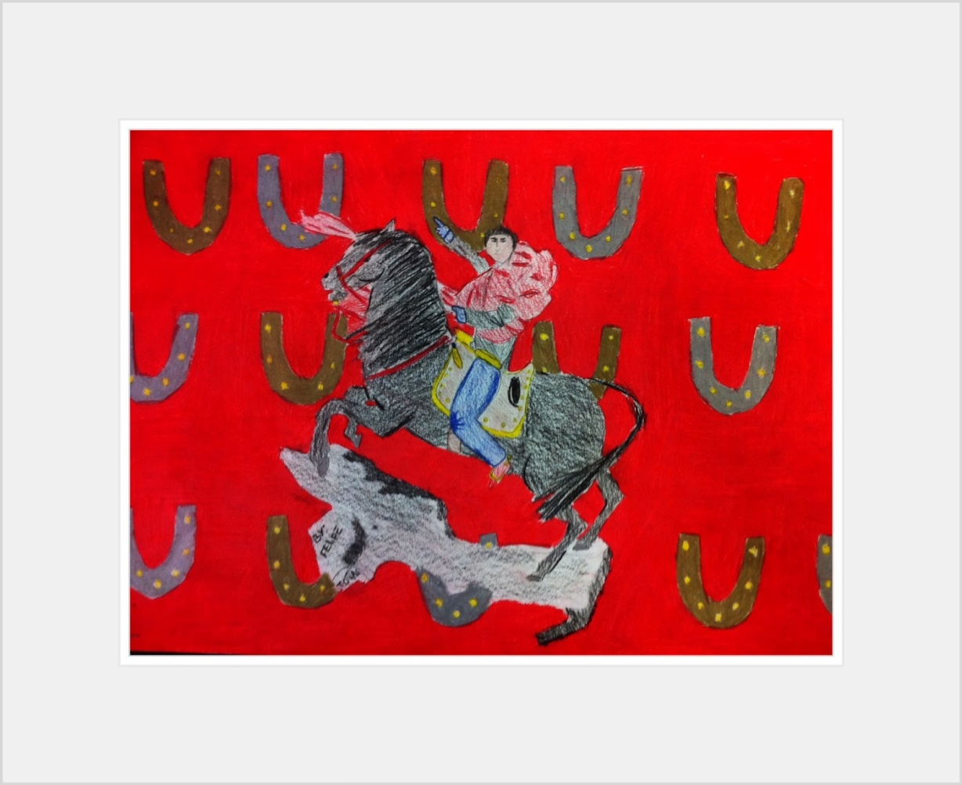

Slide 29
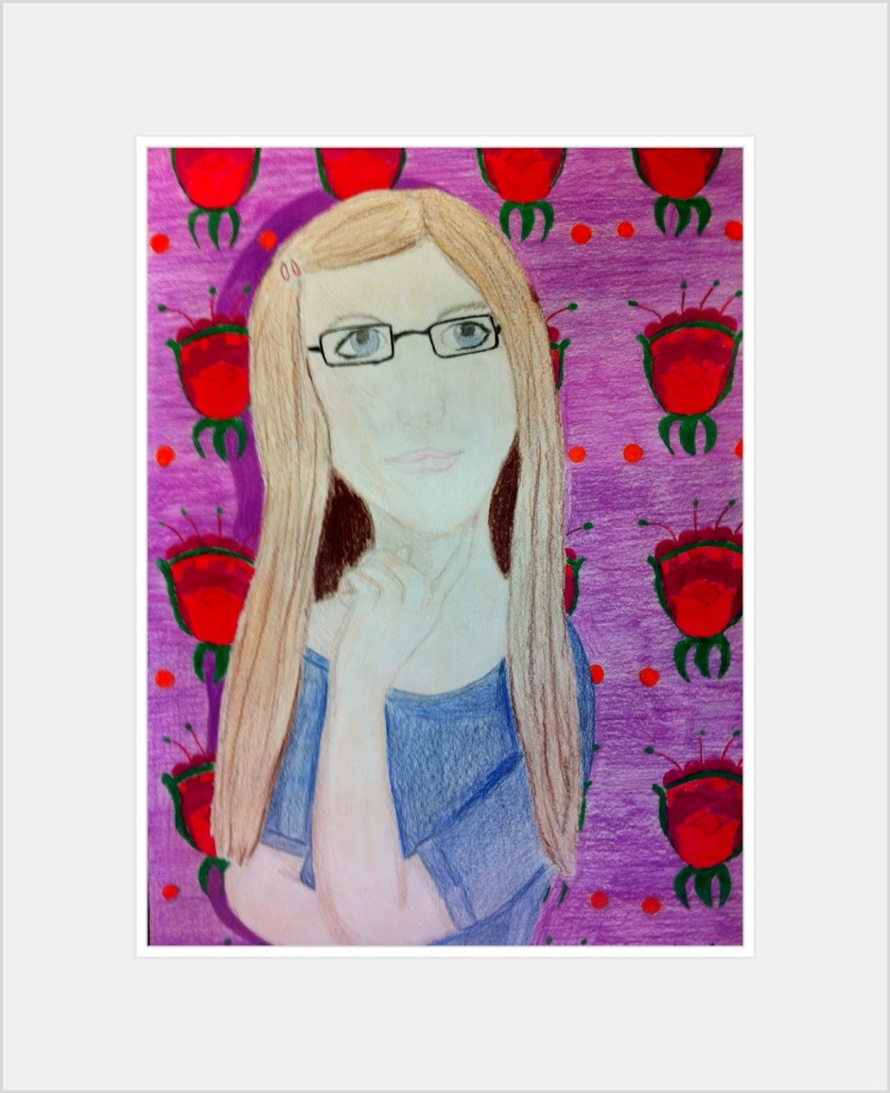
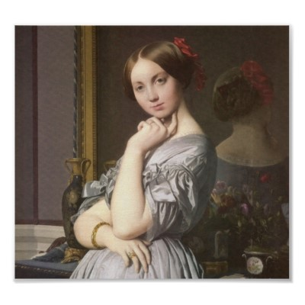

Slide 30
Procedure
Each student will complete these Brainstorming Activities:
Complete 2 Day Portrait Practice (In Class Activity)
Choose a painting to replicate for your project.
List the characteristics of the drawing: color scheme, recognizable objects, the pose of the subject.
Develop 3 different ideas using the characteristics of the painting in which you could use to modernize the painting. Instead of a cane or a book, what is something modern you could hold?
Using a piece of printer paper, draw:
A full page sketch of yourself in the pose of the painting you selected.
Think about how you are going to draw the pose. Most of the paintings are not of frontal views, therefore, you must really think about how you would look at that specific angle.
On the back, 5 different patterns that you could use for your drawing.

Slide 31
Procedure
Replicate sketch on large piece of paper:
Lightly replicate the sketch you designed on the small piece of paper onto the large piece of paper. TAKE YOUR TIME TO MAKE SURE ALL AREAS ARE ACCURATE.
Feel free to use the tools that we have used prior to this for realistic drawing: grids, portrait structure, view finders, etc.
Lightly draw in the pattern in the background of the drawing.

Slide 32
Procedure
Color in drawing:
Using colored pencils, begin to shade in your drawing. Remember to use light layers to build up color. This will help the drawing to appear more realistic.
Color neatly and slowly to ensure the color is layered evenly
End by burnishing the color into the paper for an overall smooth effect.

Slide 33
Procedure
Be creative!
This is your chance to create a Classical Contemporary Masterpiece. Feel free to switch up the objects that were in the original painting with something that is more modern or personal to you.
Craftsmanship is important because this is what you will look at many days in this class from now until the end of the year.
Create something you will be proud of and want to share.

