Slide 1
Japanese Notan Art
Shape & Space – 6th Grade Art

Slide 2
Let’s review!
What is space?

Slide 3
Let’s review!
Space is the area: Above, Below, Between, Within, & Around the main objects in a piece of art. Space is present in 2D & 3D works of art.

Slide 4
Let’s review!
What is positive space?

Slide 5
Let’s review!
Positive Space- The shapes or forms (main objects) in an artwork.

Slide 6
Let’s review!
What is negative space?

Slide 7
Let’s review!
Negative Space- The space that surrounds the main objects. It is the empty or non-interesting space between and around the main objects.

Slide 8
Let’s review!
What is the difference between a geometric shape and an organic shape?

Slide 9
Let’s review!
A geometric shape is symmetrical (the same on both sides) and an organic shape is asymmetrical (not the same on both sides).

Slide 10
Let’s review!
What does composition (in art) mean?

Slide 11
Let’s review!
Composition is the way you arrange the objects (positive space) on your paper to make it look interesting.

Slide 12
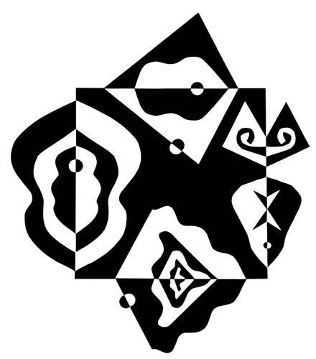
What is Japanese Notan Art?
Notan is a Japanese word that means “dark-light.”
In Japanese art, the principle of Notan is defined as the interaction between positive (light) and negative (dark) space.

Slide 13
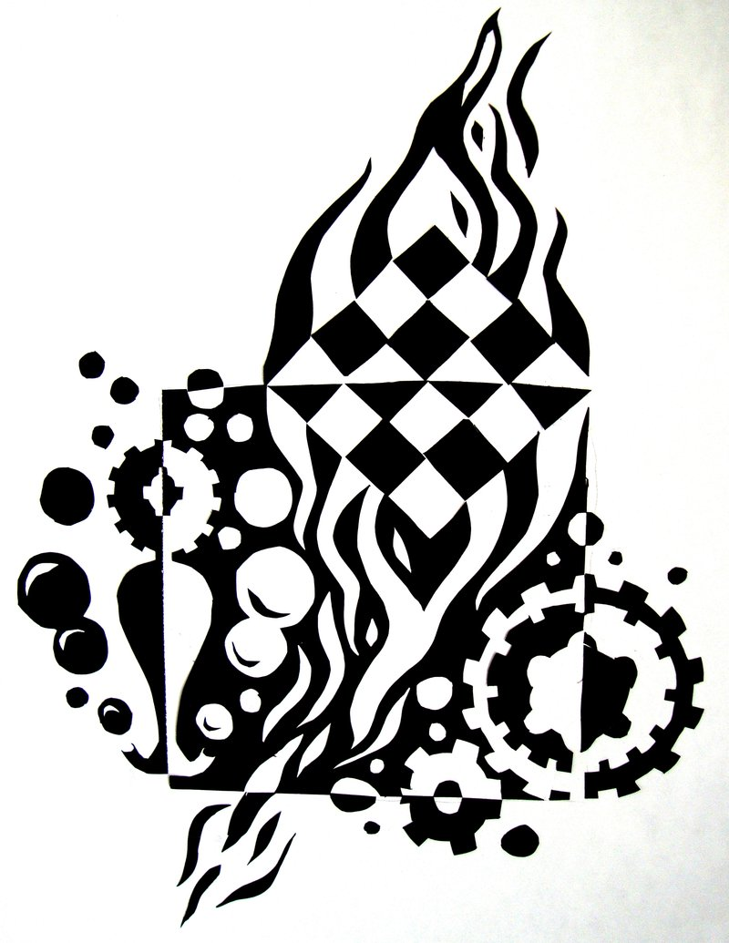
What is Japanese Notan Art?
The Big Idea: Positive areas and negative areas should complement one another.
They must coexist without one dominating the other.

Slide 14
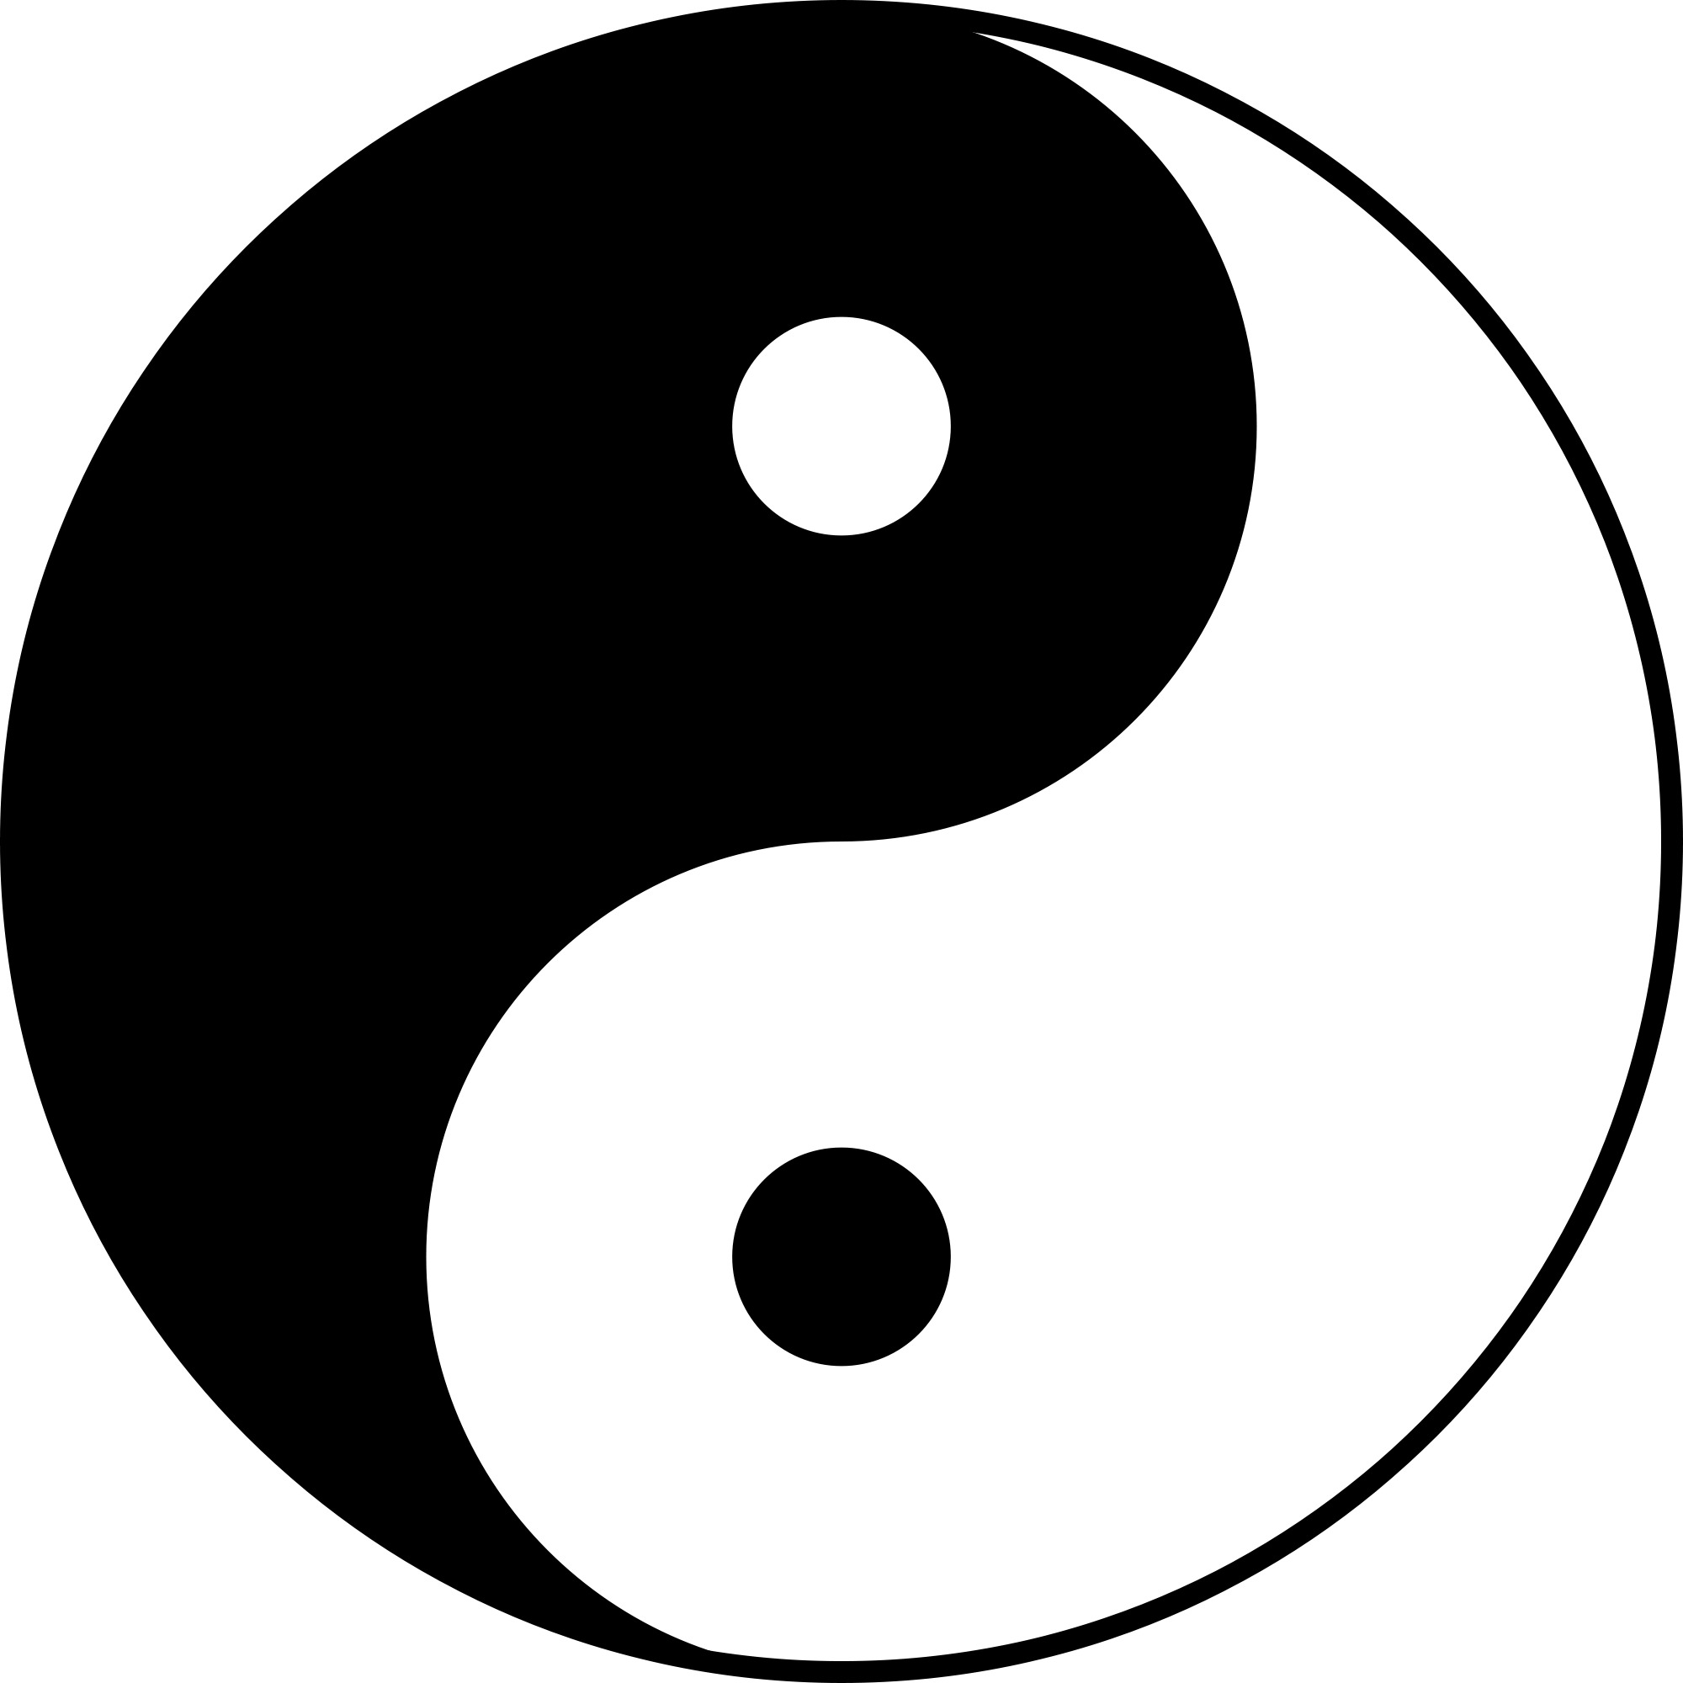
What is Japanese Notan Art?
The Eastern culture from which Notan arose, seeks a more balanced view of the world. The classic yin/yang symbol is a reflection of this desire for balance.

Slide 15
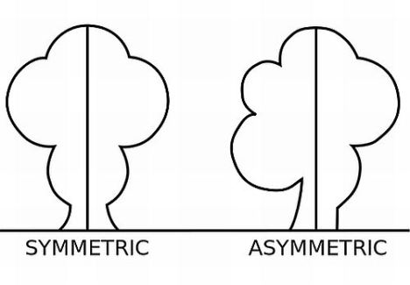
What is Japanese Notan Art?
Balance is defined as the equal distribution of visual weight in a composition.
Central Axis-An imaginary dividing line that runs down the middle of a piece of art either horizontally or vertically.

Slide 16
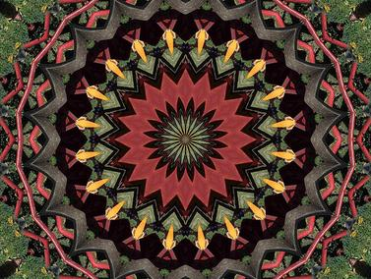
What is Japanese Notan Art?
Symmetrical balance means both sides of an axis line are the same.

Slide 17
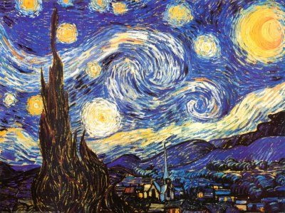
What is Japanese Notan Art?
Asymmetrical balance means each side of an axis line are different yet equal.

Slide 18
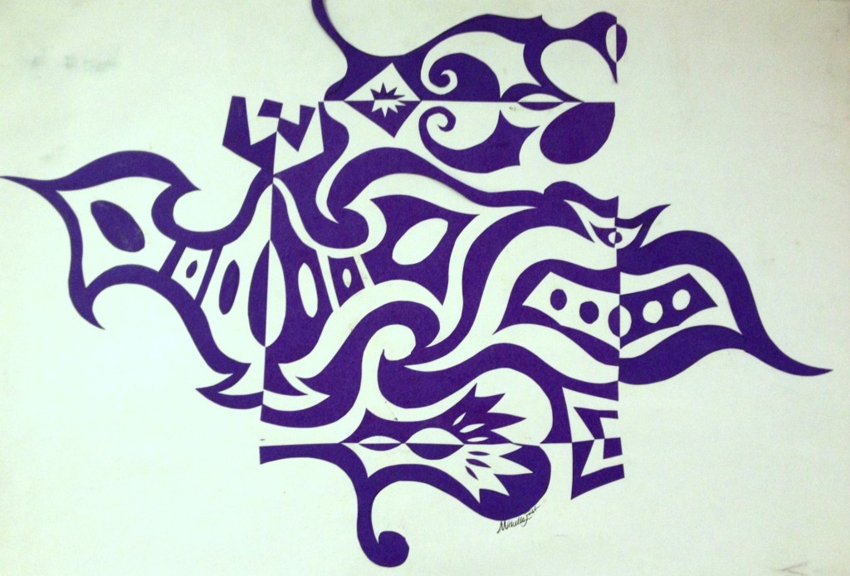
What is Japanese Notan Art?
Expansion of the Square: A Notan exercise designed to study the interaction of positive and negative space.
In order for the exercise to be completed successfully, there must be a feeling of balance created in the design.

Slide 19
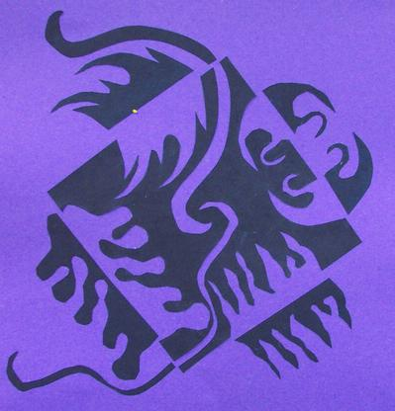
Our Project!
You are going to create your very own Japanese Notan Art using the guidelines from this Power Point and the handout given to you in class.

Slide 20
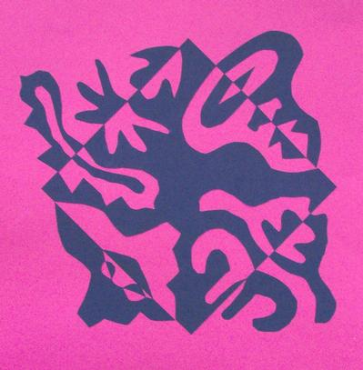
Our Project!
Key Things To Remember:
Balance
Positive Space
Negative Space
Clean cuts

