Slide 1
Week 7

Slide 2
Sketchbook #6
Look up a Greek myth on Google (if you do not have internet access, see Miss Warner) and draw a character from the myth.
Be sure to label the name of your myth!

Slide 3
Vocab #5
Armature: A framework underneath a sculpture used to support the sculpture.
Mythology: Stories meant to give meaning to all life occurrences.
Paper Mache: An art medium of torn paper and paste.
Additive: Begin with a base and “add” to create dimensionality.
Sculpture: A three dimensional form.

Slide 4
Paper Mache… What is it??
http://www.youtube.com/watch?v=pyFbWtlIWrU
http://www.youtube.com/watch?v=MgOw7bdsLOw

Slide 5
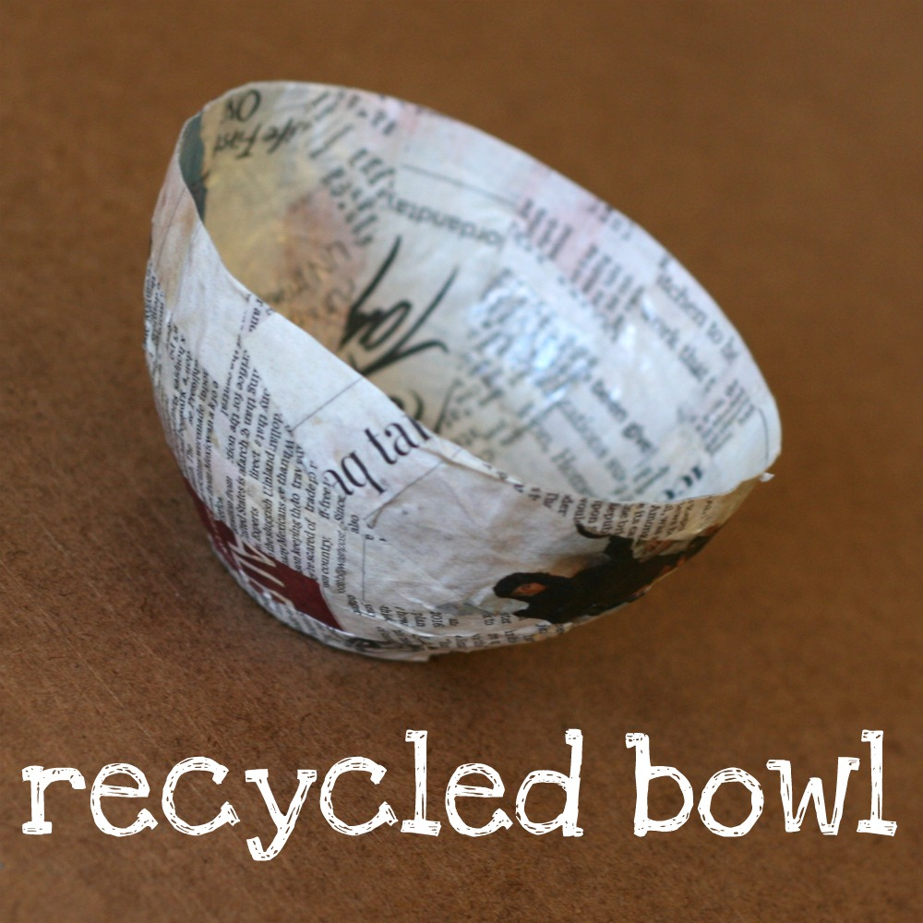
Paper Mache:
A composite material consisting of paper pieces or pulp, sometimes reinforced with textiles, bound with an adhesive, such as glue, starch, or wallpaper paste

Slide 6
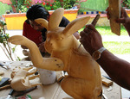
Oaxacan Wood Carvings
A type of Mexican Folk Art in which animals (both real and imaginary) are carved out of wood and painted in bright colors.
The creative process begins with the artist imagining a form (sometimes for days or even weeks), then selecting a specialty wood to carve the figure from.

Slide 7
Oaxacan Wood Carvings
Once the figure has been carved, sanded, and painted with a specialty coating to protect against bugs, a base coat is applied.
http://www.youtube.com/watch?v=MYCBaR8ZZl4

Slide 8
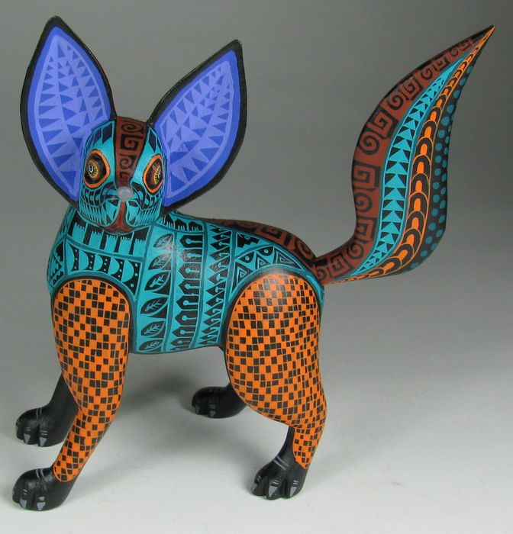

Slide 9
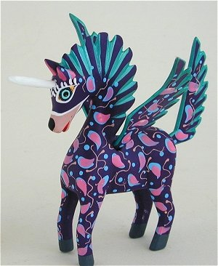

Slide 10
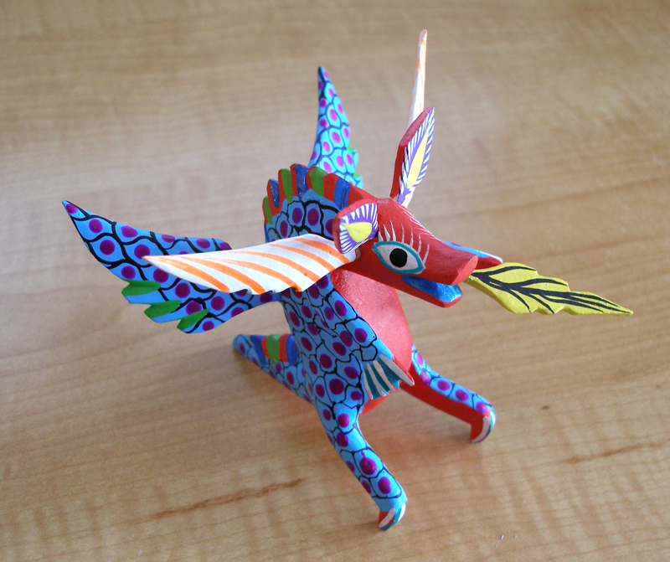

Slide 11
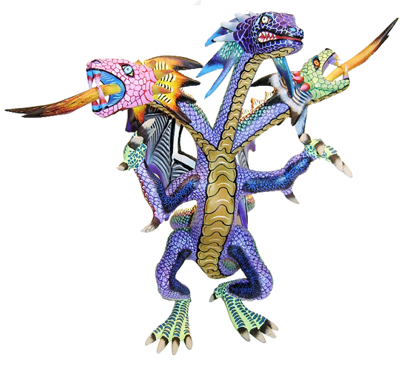

Slide 12
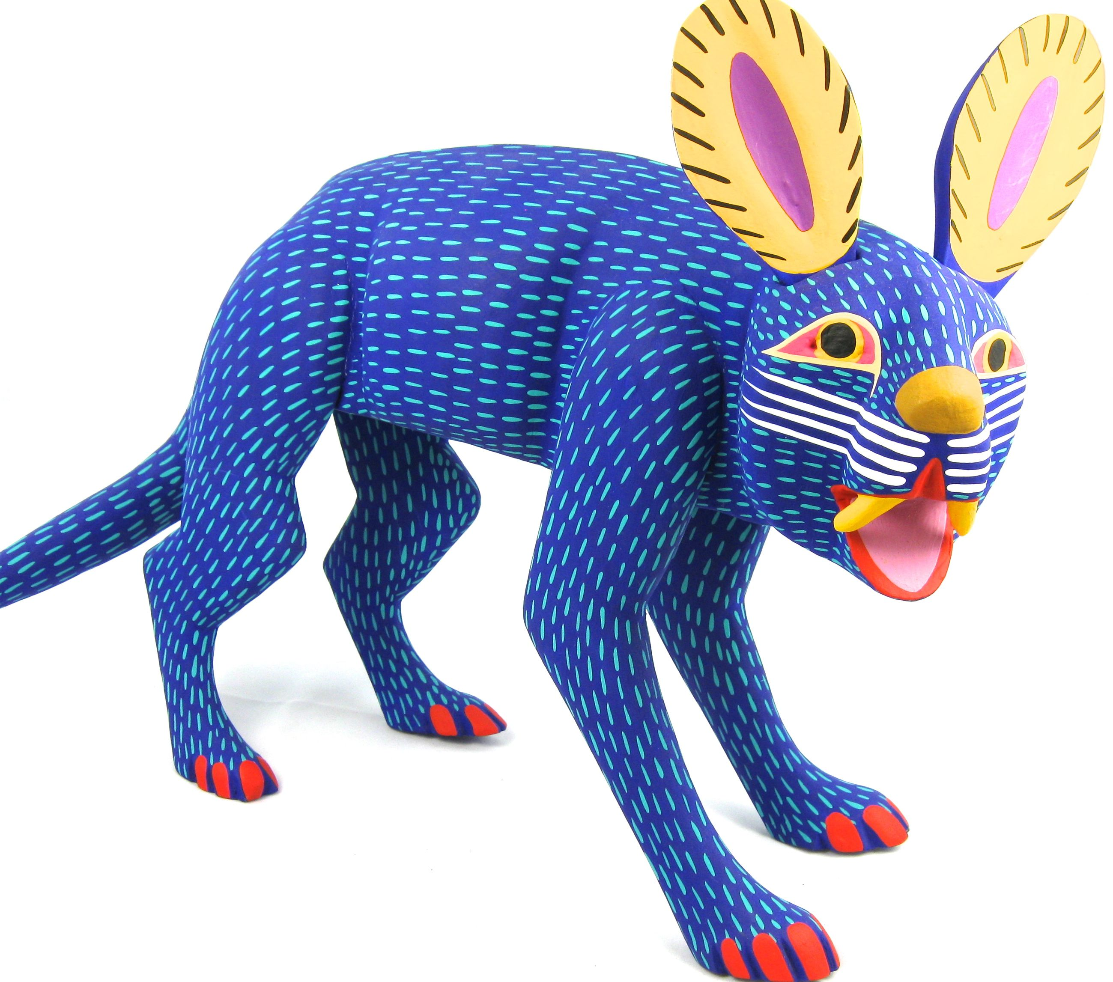

Slide 13
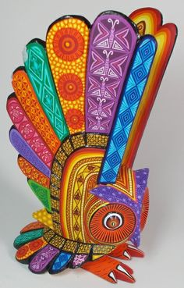

Slide 14
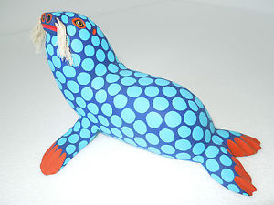

Slide 15
Project: Imaginary Creatures
We are going to create our own imaginary creatures out of paper mache.
The creatures can take characteristics from other imaginary creatures that have been created, but the final product should be a completely unique creature.
Creatures are to be no larger than 12 inches.

Slide 16
Mythology
Greek Mythology has some interesting creatures.
Mythology are stories meant to give meaning to all life occurrences.
Some examples…

Slide 17
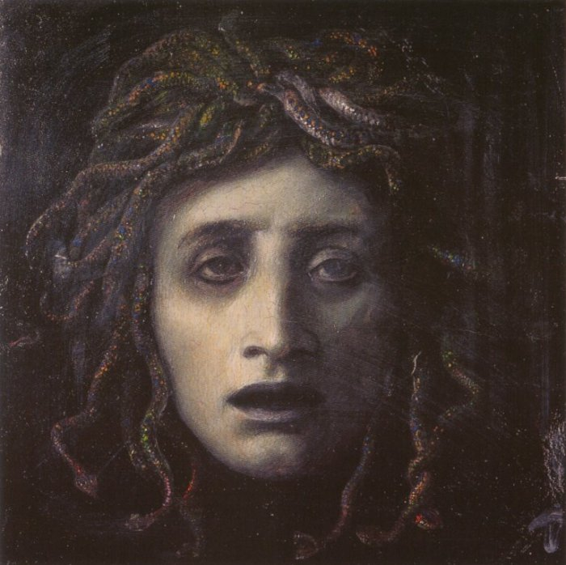
Medusa

Slide 18
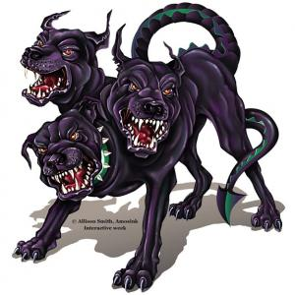
Cerebus

Slide 19
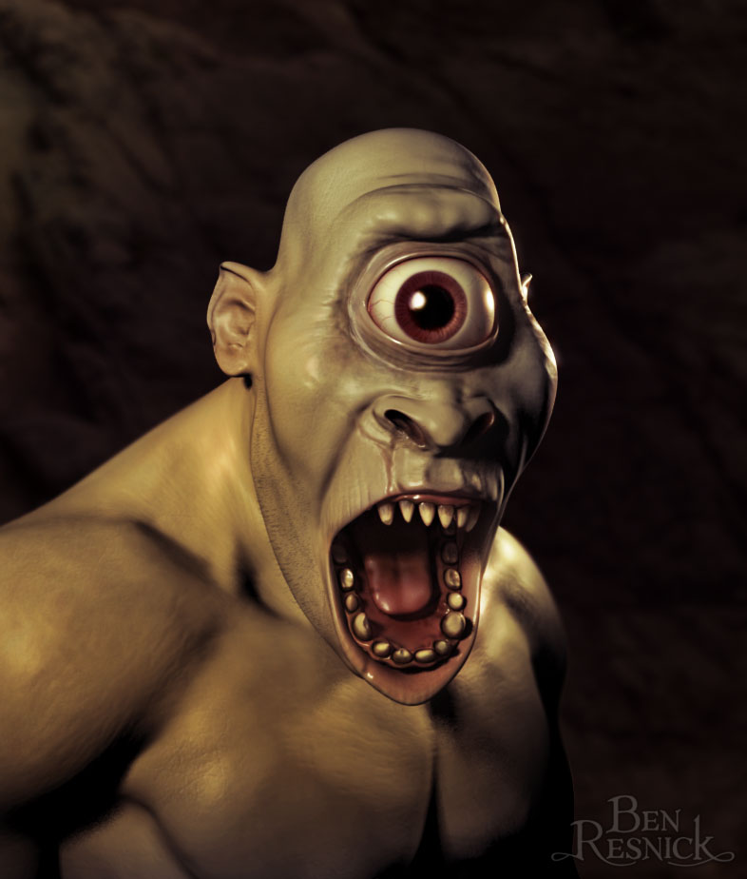
Cyclops

Slide 20
Sketch Book #7
Decide on your final creatures design and create 3 possible patterns you could include on your creature. Color in the patterns.

Slide 21
Vocab #6
Oaxacan Wood Carvings:
Layer:

