Slide 1
Color Wheel Painting

Slide 5
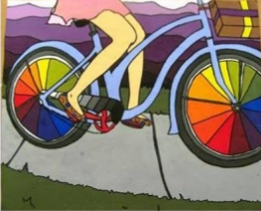

Slide 7
Things To Consider:
What will your theme be?
How are all the objects going to be acting as one picture?
Where will you use specific color schemes at?

