Slide 1
Color Theory
Miss Warner
Mixed Media 1

Slide 2
Color Theory Painting Rules:
Do NOT move on until prompted.
Mix all colors in the mixing palette provided.
Paint light, quick layers… Too much water or too thick of paint will cause your paper to tear. ☹

Slide 3
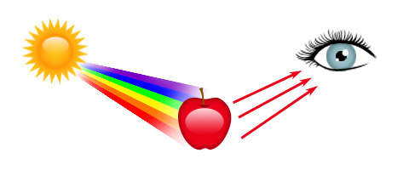
What is Color?
Color is the reflected light of an object.
When a light ray reflects off of an object, it bounces back to our eyes, and we see the color.

Slide 4
Who knew so much Science happened in Art Class?

Slide 5
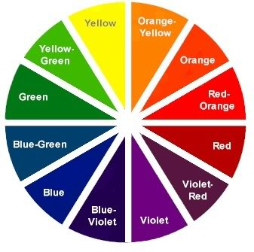
Color Wheel
A tool used to organize all colors.

Slide 6
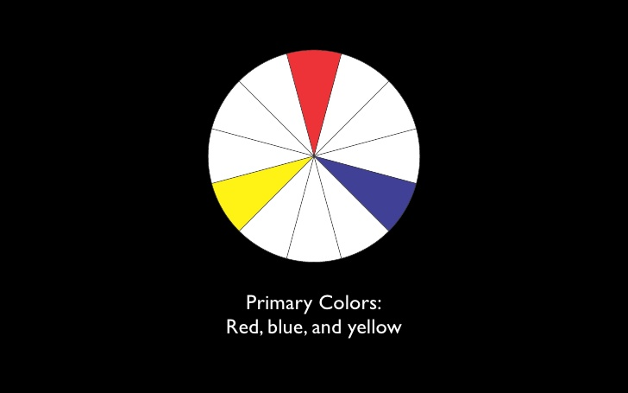
Primary Colors
Can not be mixed.

Slide 7
Try it:
On your Color Wheel, paint in the sections labeled Blue, Yellow, and Red with the appropriate colors.
Next to your Color Wheel, paint in the Primary Colors in the Primary Color boxes.

Slide 8
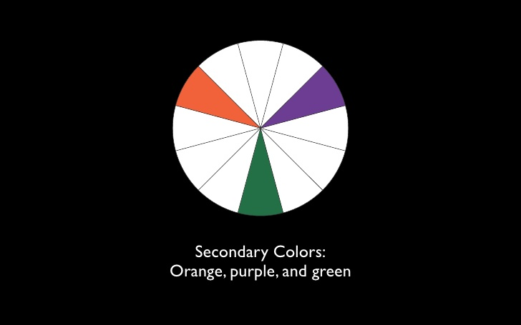
Secondary Colors
Made by mixing 2 primary colors.

Slide 9
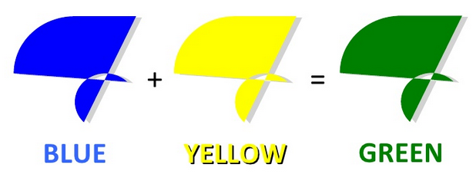
Try It: On your mixing tray, try mixing Green. Apply Green to your Color Wheel.

Slide 10
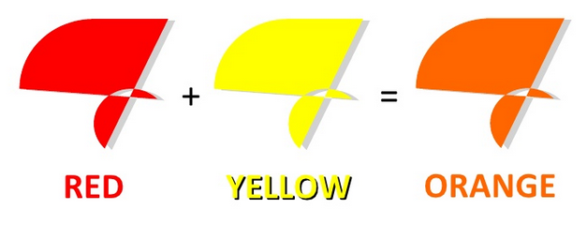
Try It: On your mixing tray, try mixing Orange. Apply Orange to your Color Wheel.

Slide 11
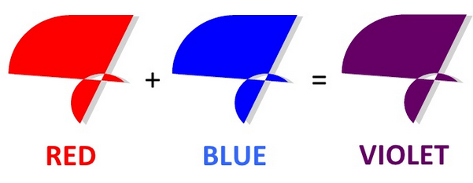
Try It: On your mixing tray, try mixing Purple. Apply Purple to your Color Wheel.

Slide 12
Try It: What colors do you use to make these Secondary Colors?

Slide 13
Tertiary Colors

Slide 14
Try It: Make Red-Orange
Yellow + Red + Red
Red is very strong, so use sparingly.

Slide 15
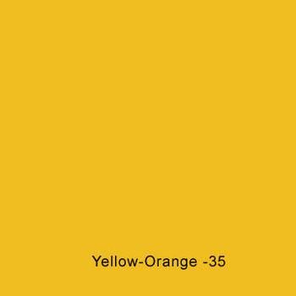
Try It: Make Yellow-Orange
Yellow + Yellow + Red
Red is very strong so use sparingly.

Slide 16
Try It: Make Yellow-Green
Yellow + Yellow + Blue
Blue is very strong so use sparingly.

Slide 17
Try It: Make Blue-Green
Yellow + Blue + Blue
Blue is very strong so use sparingly.

Slide 18
Try It: Make Blue-Violet
Blue + Blue + Red
Blue and Red are both strong colors so use with caution.

Slide 19
Try It: Make Red-Violet
Blue + Red + Red
Blue and Red are both strong colors so use with caution.

Slide 20
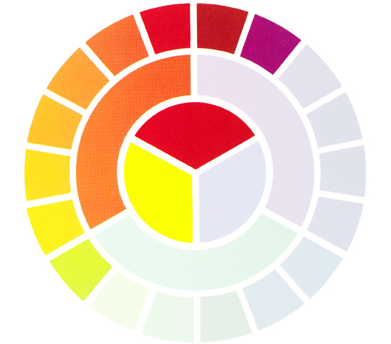
Warm Colors
Colors that we associate with the feeling or being hot or warm.
Yellow, Red, Orange
Yellow-Orange
Red-Orange

Slide 21
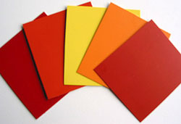
Try It: Paint in the three Warm Colors

Slide 22
Cool Colors
Colors that we associate with the feeling or being cold or cool.
Green, blue, violet
Blue-Violet
Blue-Green

Slide 23
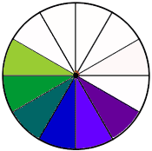
Try It: Paint in three Cool Colors

Slide 25
Try It: Pick any primary color and make several different tints.
Primary Color + White

Slide 27
Try It: Pick any primary color and make several different shades.
Primary Color + Black

Slide 28
Color Schemes
How you use and combine colors.
Common Color Schemes:
Monochromatic
Complementary
Analogous
Neutrals
Warm
Cool

Slide 30
Neutral Colors

Slide 31
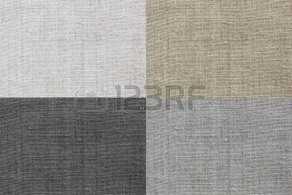
Neutral Colors
Black, White, Grey, Brown

Slide 32
Try It: Neutrals
Paint in Black in 1 Square
Paint Gray (Black + White) in the next square
Paint White (or leave blank) in the next square
Paint Brown in the final square…
BUT WAIT…
WE DON’T KNOW HOW TO MAKE BROWN! ☹

Slide 33
Complementary Colors

Slide 34
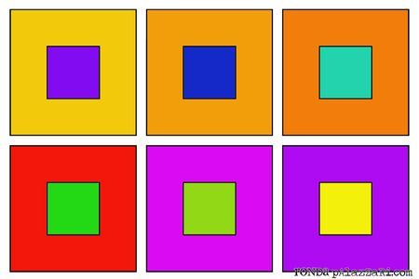
Next to each other, Complementary Colors appear brighter.

Slide 35
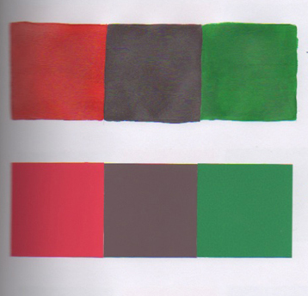
Mixed together, Complementary Colors become neutrals.

Slide 36
Try It: Complementary Colors
Paint Red in the 1st square.
Paint Green in the 2nd square.
Mix Green + Red on your palette to create a neutral.
Paint the Neutral in the 3rd square.

Slide 37
Try It: Complementary Colors
Paint Blue in the 1st square.
Paint Orange in the 2nd square.
Mix Blue + Orange on your palette to create a neutral.
Paint the Neutral in the 3rd square.

Slide 38
Try It: Complementary Colors
Paint Violet in the 1st square.
Paint Yellow in the 2nd square.
Mix Violet + Yellow on your palette to create a neutral.
Paint the Neutral in the 3rd square.

Slide 41
Try It: Paint 3 different sets of Analogous Colors

