Slide 1
Color
Elements of Art

Slide 2
What is Color?

Slide 3
What is Color?
Color is an Element of Art.
What are the other 3 Elements of Art we have learned about?
How do we see Color?
Color comes from light; if it weren’t for light we would have no color.
Light rays move in a straight path from a light source.
Within these light rays are all the rays of colors in the spectrum or rainbow.
When the light rays hit an object our eyes respond to the light that is bounced back and we see that color.

Slide 4
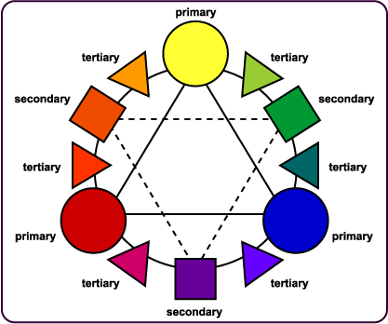
Color Wheel
What is a Color Wheel?
Color Wheels are a tool used to organize color.

Slide 5
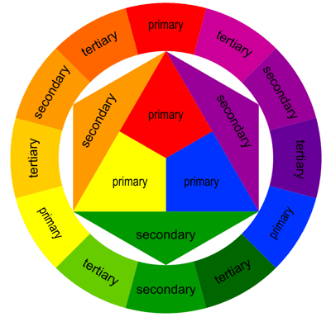
How do we read a Color Wheel?
A Color Wheel consists of several different parts of colors:
Primary Colors
Secondary Colors
Tertiary Colors
Complementary Colors

Slide 6
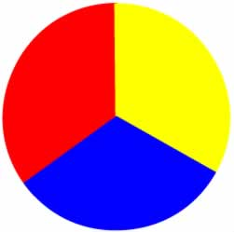
Primary Colors
Primary Colors:
Red, Yellow, Blue
Primary Colors cannot be mixed! They are found in nature, and they must be bought in some form.

Slide 7
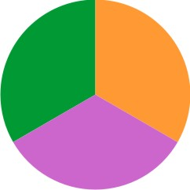
Secondary Colors
Secondary Colors:
Orange, Purple, Green
These colors are created by mixing two primaries.
Blue + Yellow = Green
Red + Yellow = Orange
Blue + Red = Purple

Slide 8
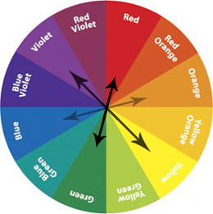
Complementary Colors
Complementary Colors are colors that are opposite each other on the color wheel.
When placed next to each other they look bright.
When mixed together they neutralize each other, and make browns or blacks.

Slide 9
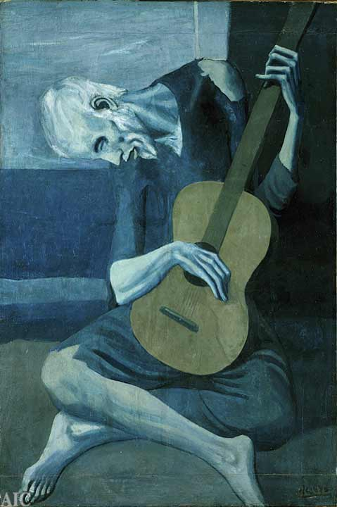
Color Harmonies
Color Harmony is when an artist uses certain combinations of colors that create different looks or feelings.

Slide 10
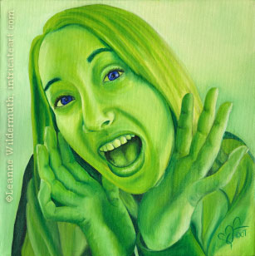
Monochromatic
Monochromatic is where one color is used but in different values and intensity.

Slide 11
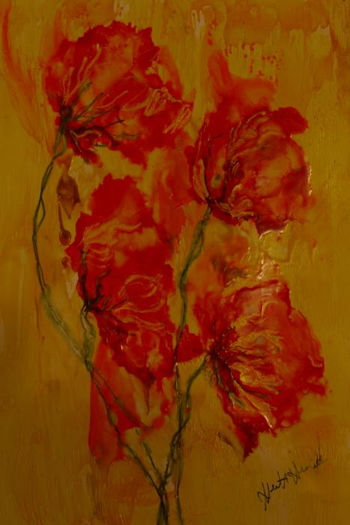
Warm Colors
Warm colors are on one side of the color wheel and they give the feeling of warmth.
For example red, orange and yellow are the color of fire and feel warm.

Slide 12
Cool Colors
Cool colors are on the other side of the color wheel and they give the feeling of coolness.
For example blue, violet, are the colors of water, and green is the color of cool grass.

Slide 13
Let’s Review!!

Slide 14
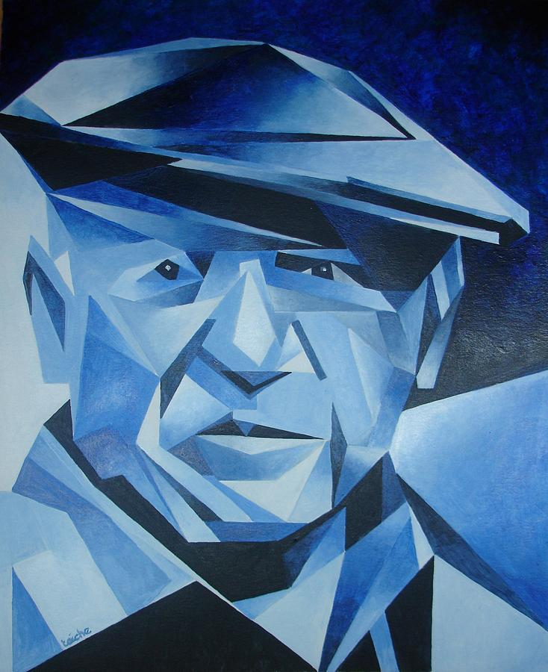
Which Color Harmonies?

Slide 15
Which Color Harmonies?

Slide 16
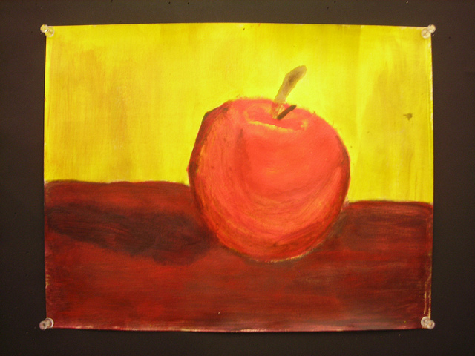
Which Color Harmonies?

Slide 17
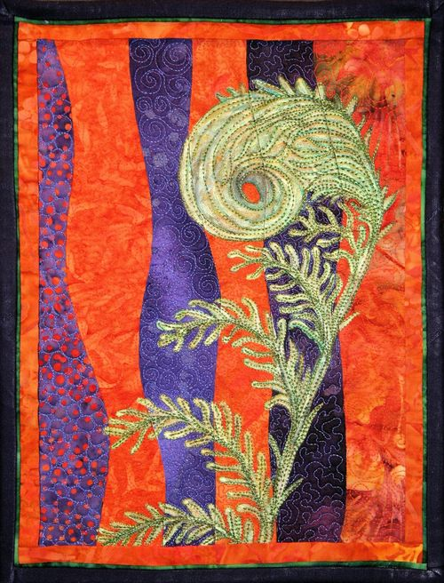
Which Color Harmonies?

Slide 18
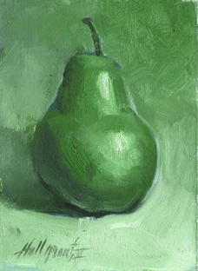
Which Color Harmonies?

